Slide 1
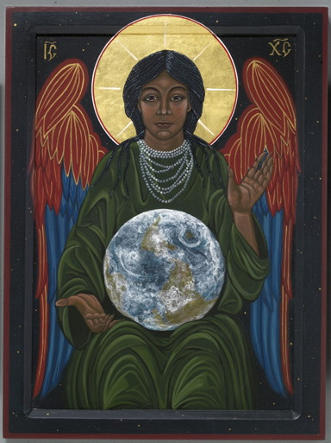

Slide 2
How do I experience Wisdom seeking me and graciously making herself known to me?
In difficult times, what practices or companions open me to the playful, imaginative joy of Wisdom?

Slide 4
Where are you getting your oil? How is your oil supply at the moment?
How do you feel about sharing your oil with others who are less prepared?

Slide 6
At a practical level, how might we step out in faith, look fear in the face and meet the challenges of today and the weeks ahead?
What does uncommon courage look like today?

