Slide 1
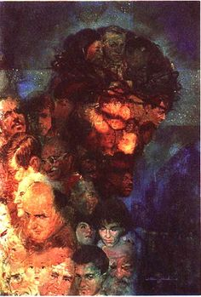

Slide 2
What is this body of Christ that we are part of?
What does it mean for you to participate in the body of Christ?
Are we one body on the cross? One body with victim, executioner, observers?

Slide 3
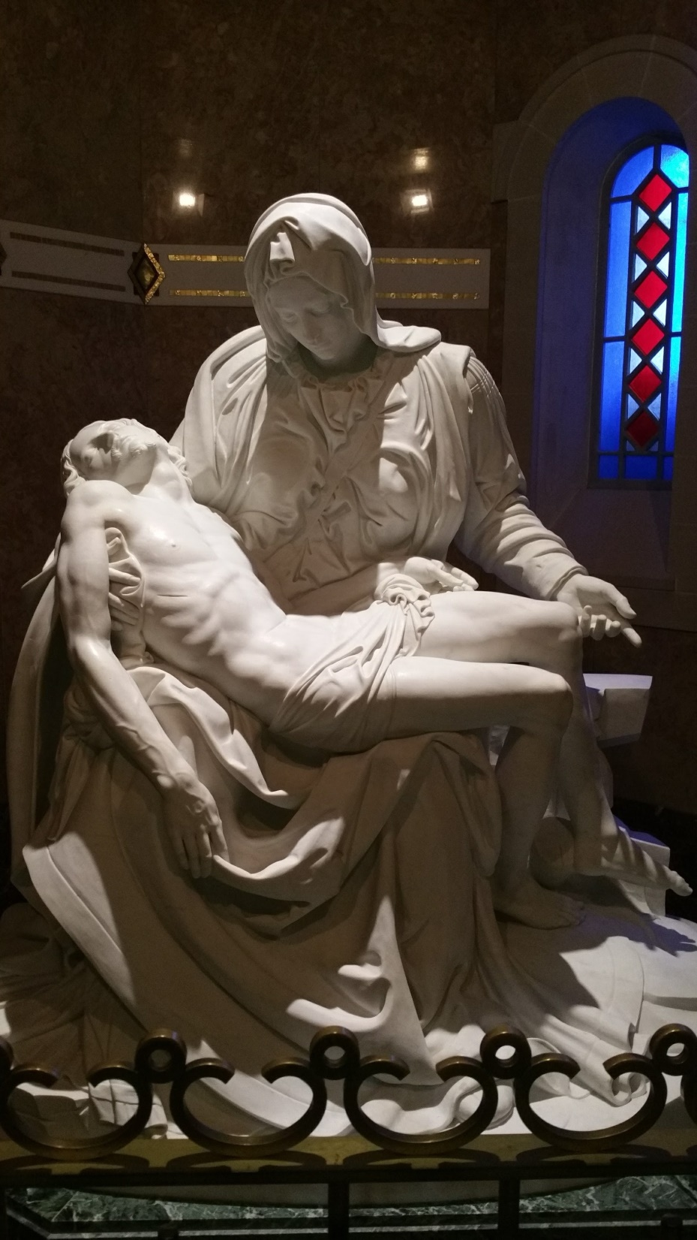

Slide 4
For what do you lament?
How is your voice different when you are on the cross, or at the foot of the cross?
To what do you need to say Amen with your life?

Slide 6
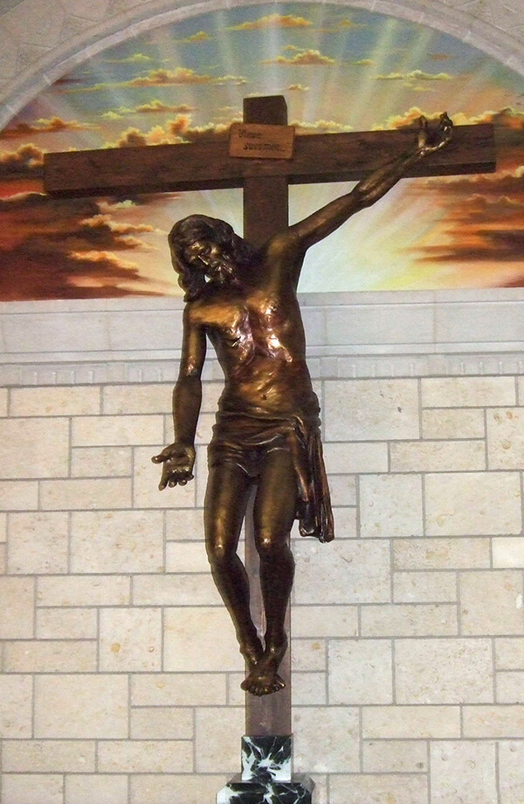
With what we have just heard, with all we lament,
ask yourself:
How am I being invited into communion with or through Jesus right now?
How will I respond to this invitation into communion in the body of Christ?

