Slide 1
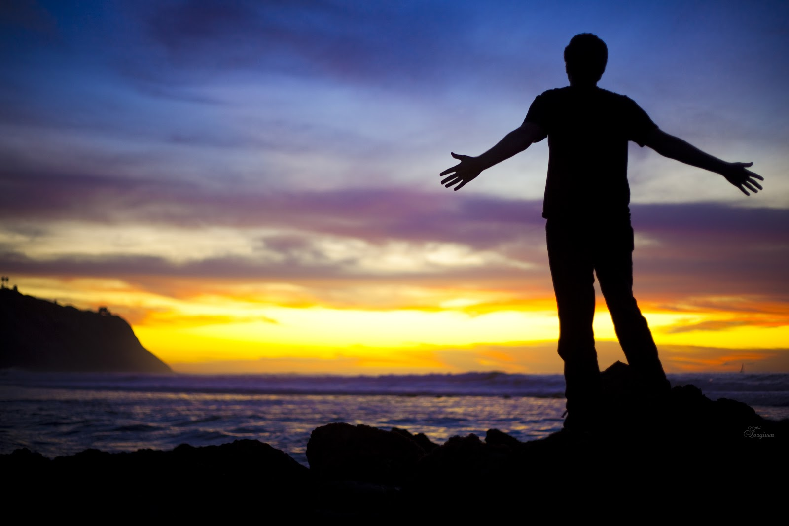
How will you wake up each
morning and challenge
yourself to prioritize God
above all else each day?
When you examine your
own heart, what do you
value the most? What is
most important to you in
your life? What would it be
like to give that up?

Slide 2
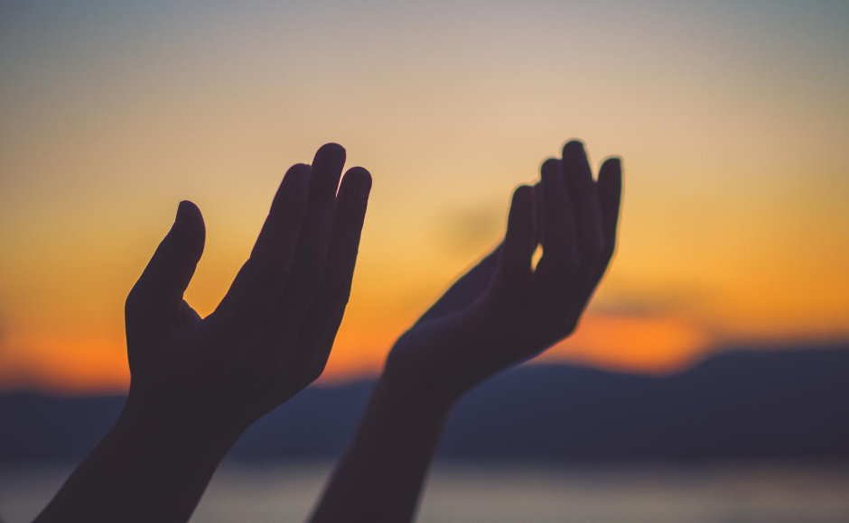
What “small acts” do you carry out daily to give value to others?
In a polarized time, how do you hold together the priority of your witness to Christian values and your call to “be communion” in our fractious families and world?
This Photo by Unknown Author is licensed under CC BY-NC-ND

Slide 3
How do you make God’s love and grace enough for yourself? For those who surround you?
What are you willing to “return to God?”

