Slide 1
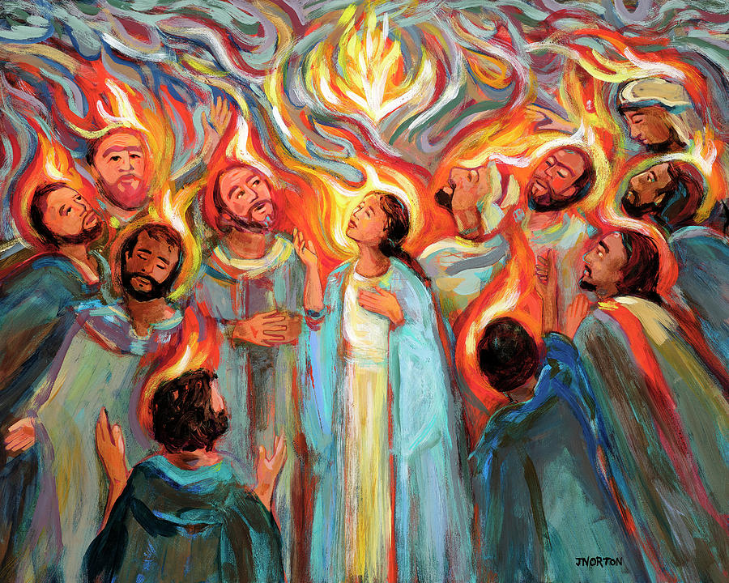

Slide 2
We are from the East Coast, the South, California, the Midwest, Canada and Europe. We are older and middle aged, professed religious and single and married, parents, workers, retired. Just like the first followers, we too hear many people speaking to us of the mighty acts of God. Spend some time reflecting on how your faith has been shaped by people who seemingly are very different from you.
When have you had a time when your experience transcended any differences in language?

Slide 3
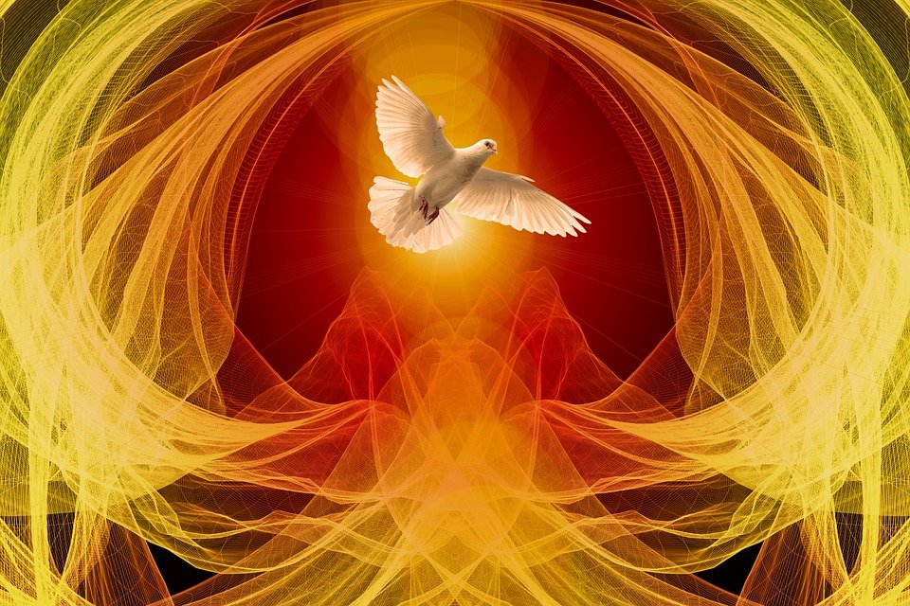

Slide 4
What is it like to be breathed on by God?
What do you experience when you hear God say you or any one of us can forgive sins or be the one to retain sins?

Slide 5
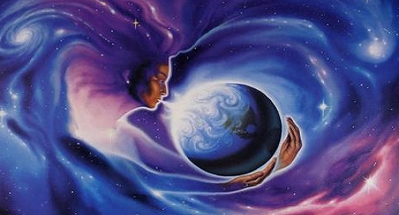

Slide 6
When have you felt another’s breath? What was that like for you?
How do you recognize the Spirit in others?
If breathing is speaking God’s name, how does it feel to know it is heard the loudest when we are quietest? How does it feel to quiet yourself to hear God’s voice?

