Slide 1
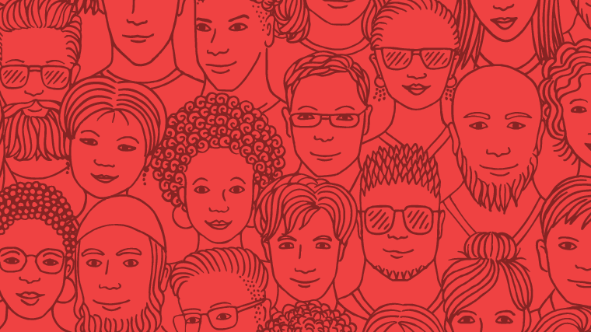
How do you see yourself as “Blessed”? From where or from whom do you receive your blessings? Which of these blessings resonates most strongly in you?

Slide 2
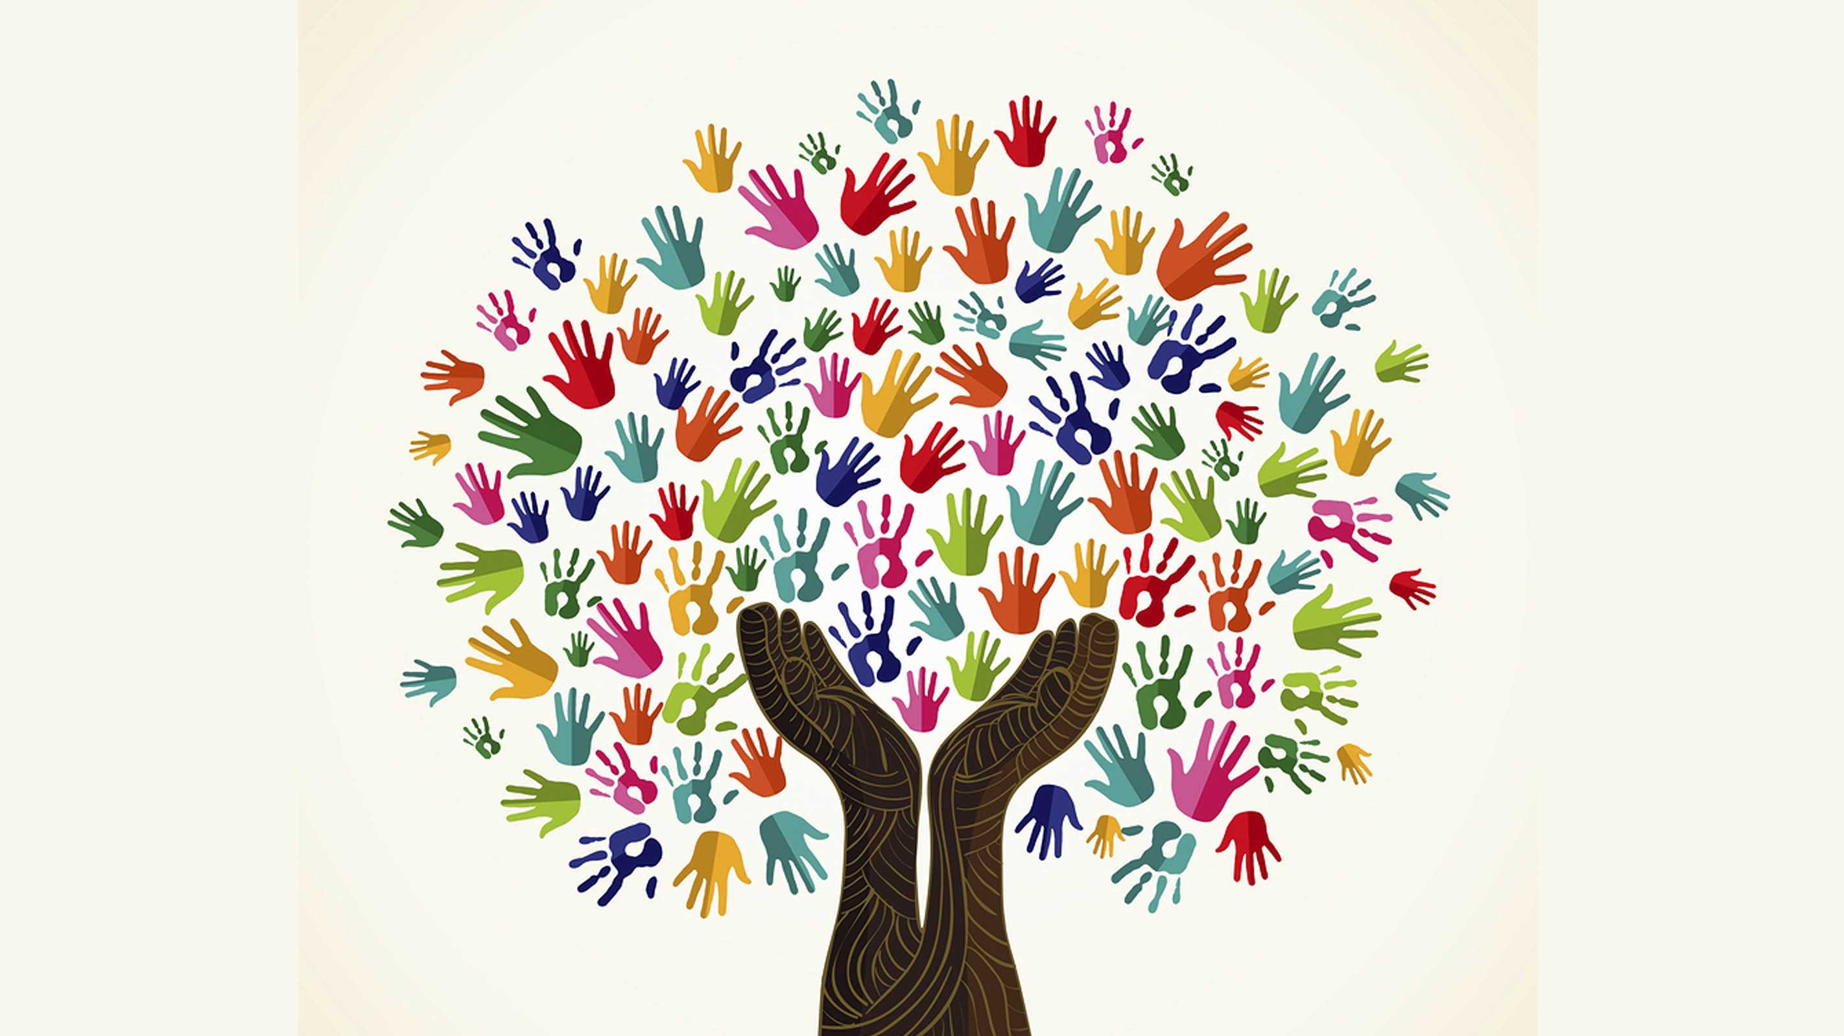
How have you felt when you experienced doing small things for others, or having others doing small things for you?
God’s kingdom breaks in everywhere: on street corners and school yards, in sanctuaries and soup kitchens, among sinners and saints. God’s kingdom is among us. Where do you see it? How do you feel it?
How do you try to answer the video’s final question - What is it you desire most?

Slide 3
Which saint, or person who has gone before you, do you call on for intercession to God, for continued strength or guidance?
What draws you close to those who intercede on your behalf?
For whom or what do you mourn?

