Slide 1
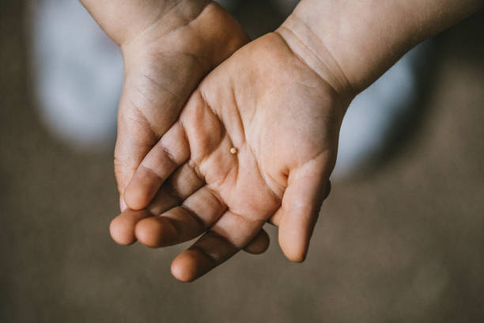
What is behind the
frustration and impatience
that arises in you?
What is it that you do
to overcome
your inner turmoil
to find peace?
A single mustard seed in the hand of a child

Slide 2
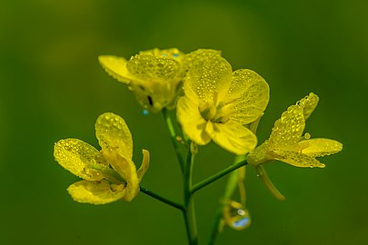
When have you seen a faithful response to a situation generate a surprising outcome?
What has enabled your
trust in the Good News
to grow and deepen?
When have you had hands
placed on you in a way
that changed you?
The flower of a blooming mustard plant

Slide 3
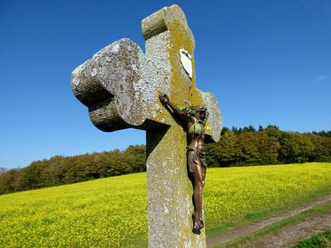
What has given you hope to respond to a seemingly overwhelming problem?
What has inspired you to expand your prophetic imagination? What new images and symbols do you see?
Cross framed against a field of mustard plants in bloom

