Slide 1
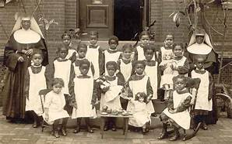
Mother Lange and the Oblate Sisters’
school

Slide 2
When does religious humility require us to remind one another of our equal status as children of God? How can we be humble and still insist on human dignity?
How does it feel to know that sometimes deliverance comes from the hands of a someone who seems an adversary?

Slide 3
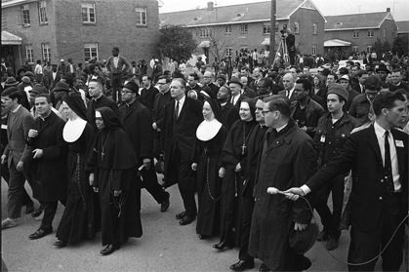
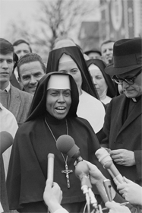
The march in Selma

Slide 4
When have you felt called to disagree with the government or those in authority? Did prayer help to inform your decision? How did you feel? Were you afraid?
What do these stories of African American women religious call forth in you?

