Slide 1
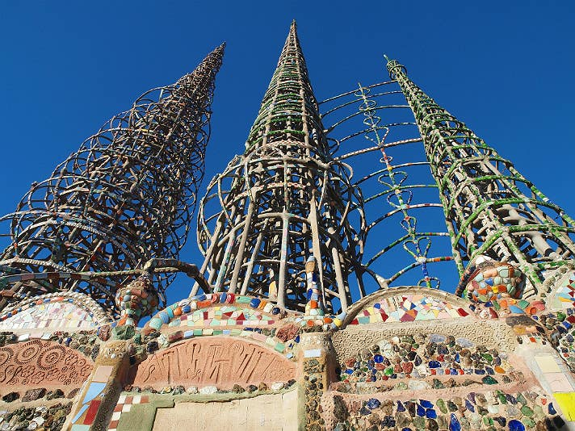
What is it like for you to hear a promise of safety while you feel danger very near?
How would you change if you lived in a city that claimed the name “The Holy One is our justice”?
Watts Towers by Simon Rodia, Los Angeles

Slide 2
What signs have you seen that signal the coming of the reign of God?
When is it hard for you to stay vigilant? How do you manage that?

Slide 3
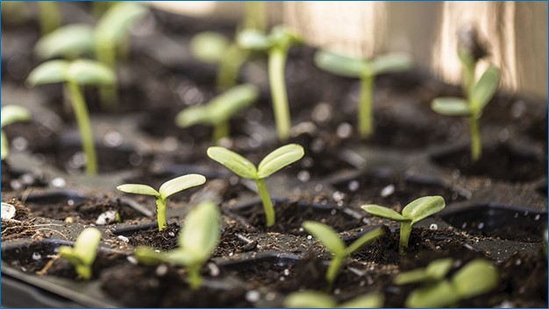
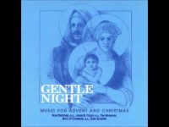

Slide 4
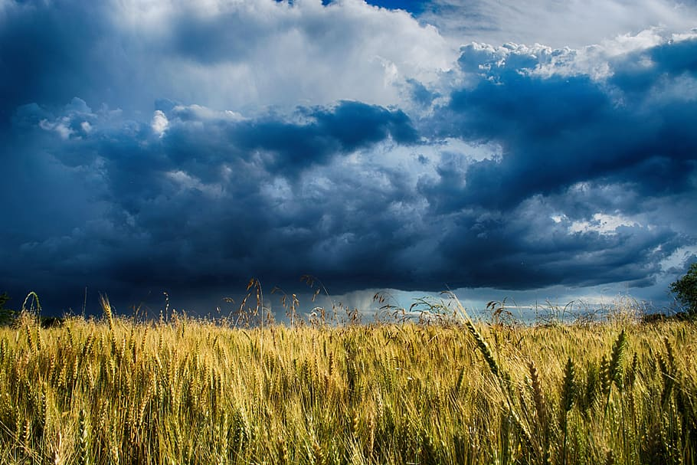
How do you remain
patient, and trust that
transformation is
occurring in the midst
of calamitous times?
What is your great hope for the coming of God in our day?

