Slide 1
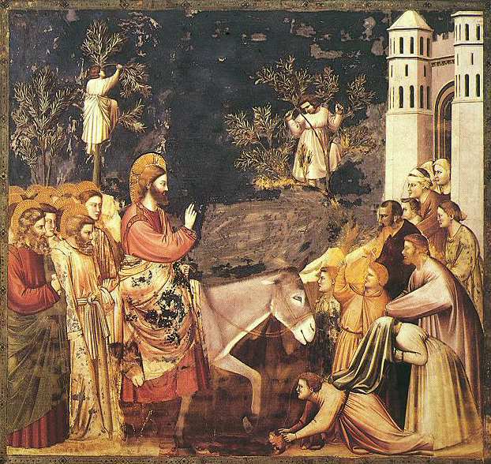

Slide 2
We hear of both dominion and liberation in these readings. How do these images change your vision of Christ the King?
What does it mean to you to be part of Christ’s kingdom?

Slide 3
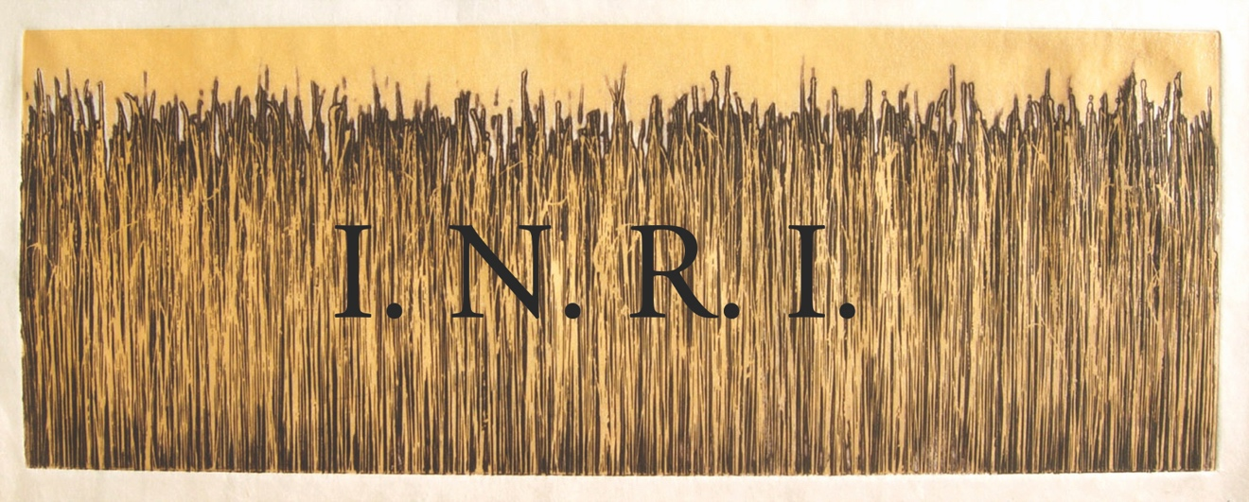

Slide 4
Pilate ordered an inscription on the cross “Jesus the Nazarean, the King of the Jews.” What might you have thought if you had seen this inscription—what sort of king could this be?
Is Jesus your king, or have you chosen others?

Slide 5
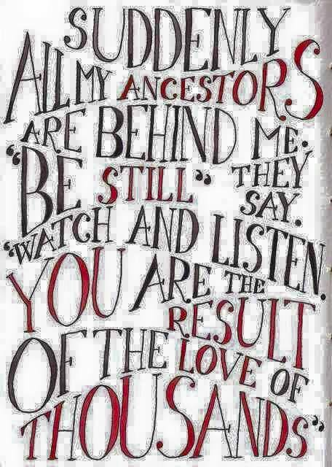

Slide 6
How do you imagine your Loved Ones experiencing the Kingship of Christ?
How do you receive support from your beloved ones in eternal life?

Slide 7
What does it mean to you to “be restored”? What challenges you?
What are the sources of joy, wisdom, and discernment for you in these critical times?
When have you seen transformation happen as an outgrowth of genuine Christian living?

