Slide 1
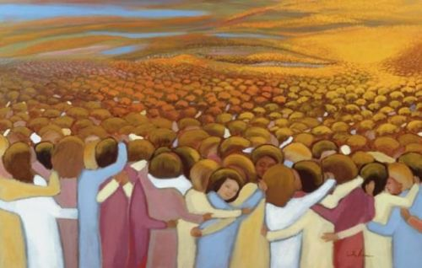

Slide 2
How do you experience the communion of saints?
In this great multitude of saints,
who are you called to be?
What is your vocation?

Slide 3
Which of these beatitudes evokes
a strong feeling in you?
Spend some time with that feeling.
The beatitudes ask us to live
a countercultural life.
How do you experience
insults or rejection in doing this?
How do you experience blessing in this?

Slide 4
How do you lean on grace?
In the weeks and months after the election, what beatitudes or personal saints
will help shape who you want to be?

