Slide 2
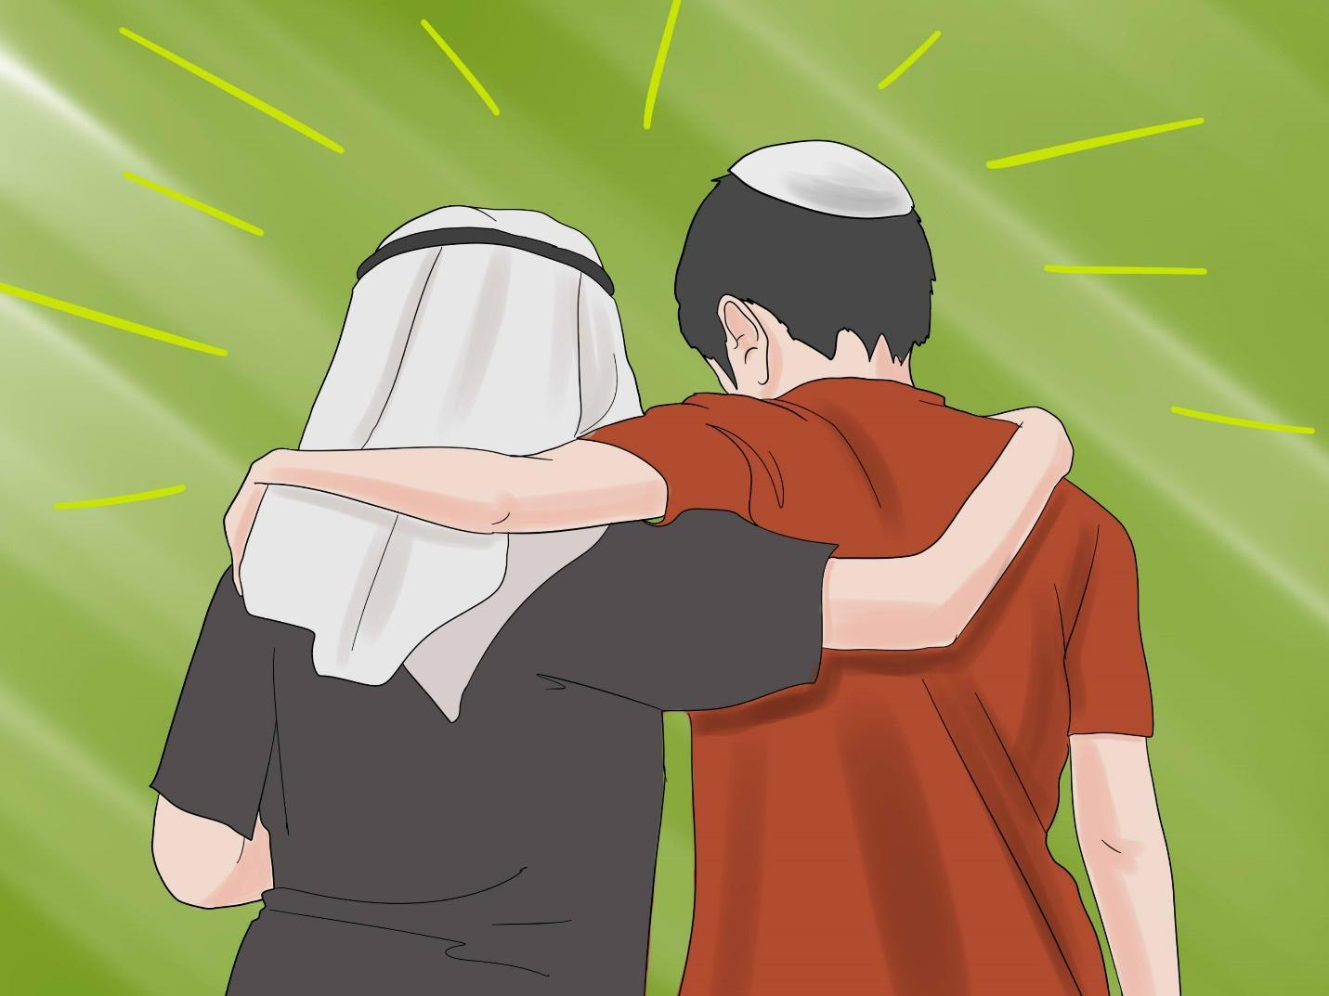
What in this story can guide you toward action about injustices in the Church now?
Recall a time when you were an outsider in a group.
What did people do either to
keep you outside, or to make you at home?
How would you feel if a leader fully entrusted an important problem to
the group as a whole?
Muslim and Jewish boys

Slide 3
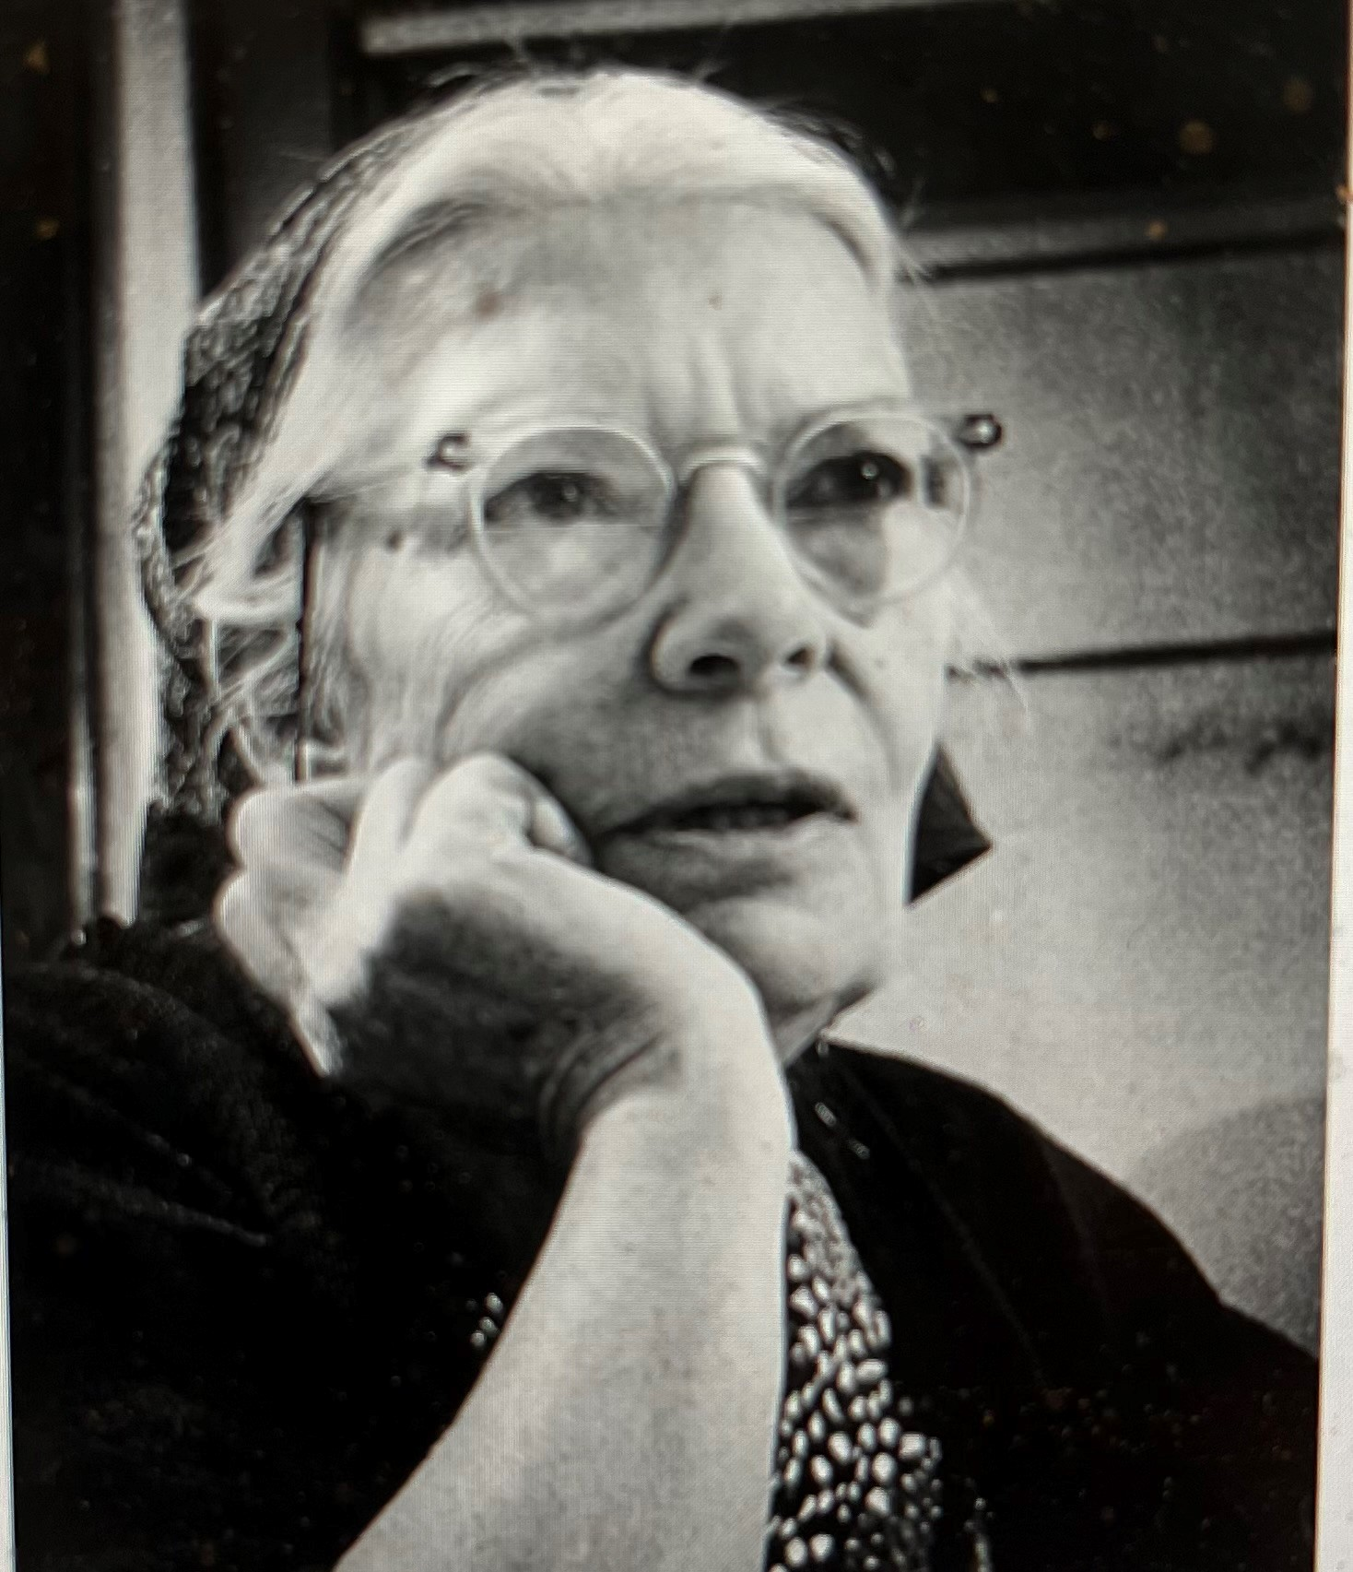
What creative ways can be used to bring the marginalized into the mainstream of Church life? How can you as an individual do the same?
When have you been part of
a community whose
demographics changed in
important ways? How did this
change you and your
relationship to the community?
Pope Francis refers to undefined
but real “ministries” beyond the
traditional list. How would you
name your personal ministry?
Dorothy Day, founder of
the Catholic Worker Movement

Slide 4
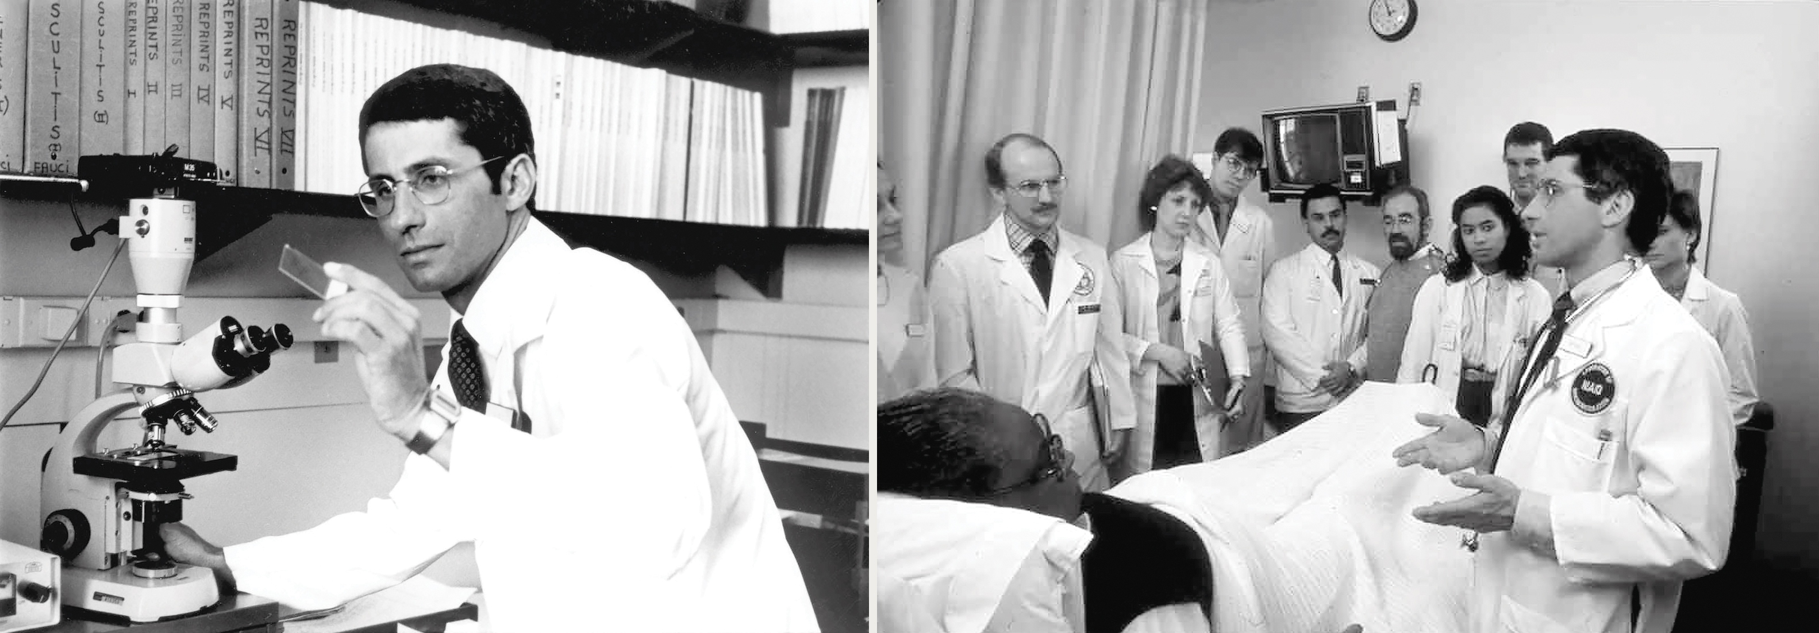
How has someone inspired you to follow Jesus’ radical way of
selfless service to others?
In your daily life, in what ways are you choosing Jesus as your “way?”
What other “ways” are you tempted to choose?
How can you do greater works than Jesus?
Dr. Anthony Fauci - Global Program providing treatment for millions of people with AIDS.

