Slide 1
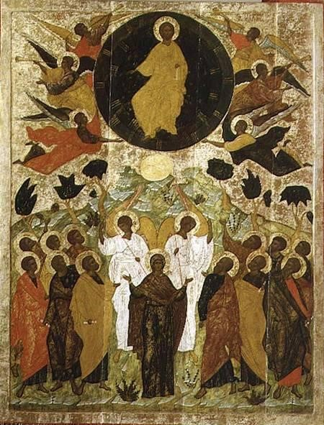
What has helped you to understand how to be Jesus’ witness?
What wisdom or hope have you gained by seeing with eyes of the heart?
When have you been thunderstruck by the power of the Holy Spirit?
The Ascension, Russian, Novgorod School

Slide 2
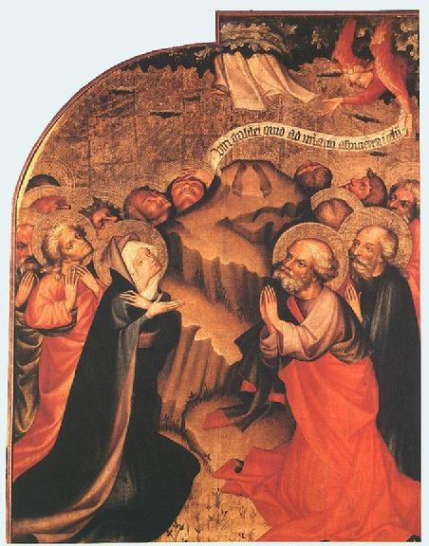
What are the pros and cons of doubt for you?
How do you stay grounded in the power of Jesus?
How has your life been impacted by the promise of Jesus to be with you always?
The Ascension, Master Thomas de Coloswar, 1427

Slide 3
When have you been handed a ministry you did not feel ready for?
What helps you move from “doubt and fear” to “trust and peace?”
What experiences give you post-resurrection hope?
Ascension © Jan Richardson. janrichardson.com

