Slide 1
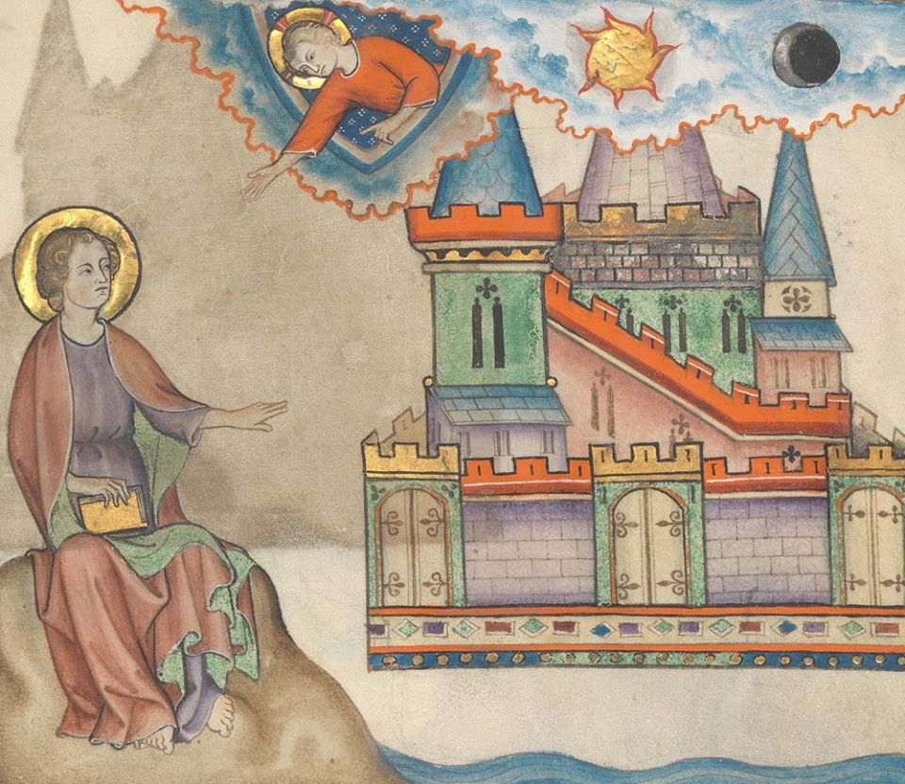
Think of a time when God wiped away your tears. What feelings arise?
How do you experience God dwelling with us?
For what do you hope as you contemplate the evolving future of the people of God?

Slide 2
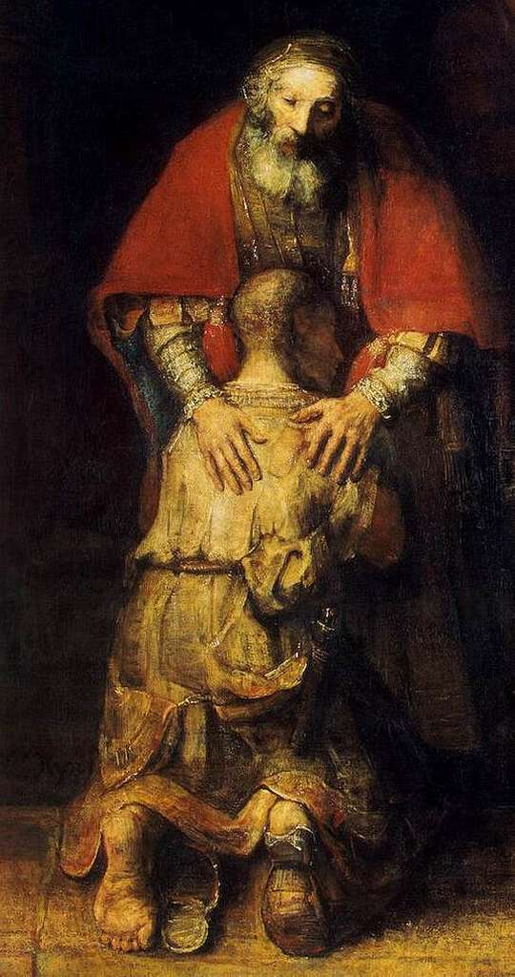
What helps when this commandment is hard for you?
How has giving yourself in service affected you?
Where do you see the power of forgiveness at work?

Slide 3
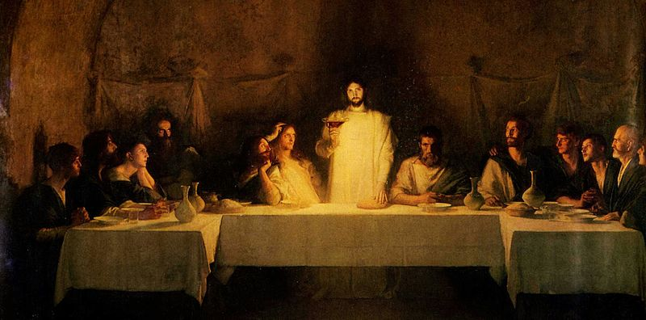
What “impossible dream” have you seen become possible through faith?
How does your “communion with Jesus and one another” show up in the world as “sacrament”?

