Slide 1
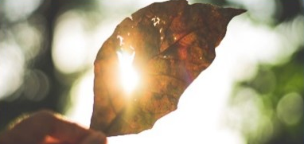
How does your light shine?
When does your light tend to grow dim?
Recall a time when you found light shining where you didn’t expect it.

Slide 2
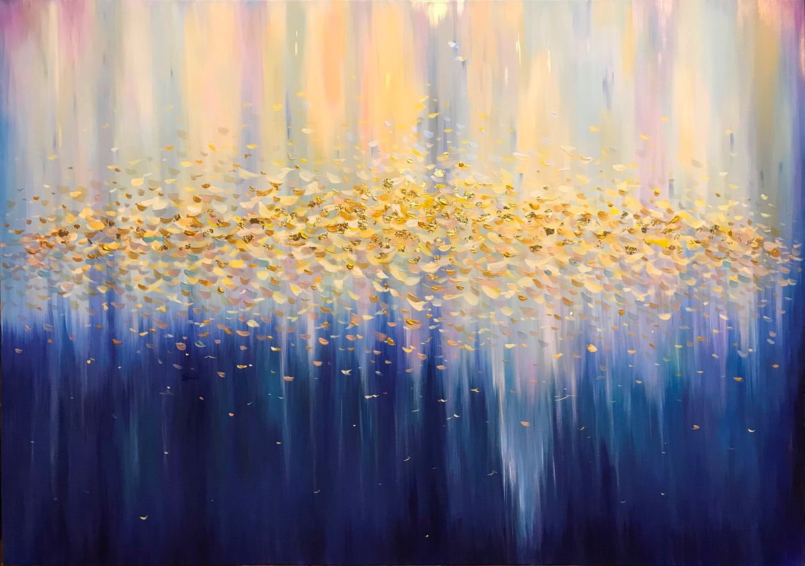
When have you felt your light leap up in response to another’s light?
How do you respond to ‘that glimpse of how things really are’?
When have you wanted to set up structure when God wanted you to stay loose?

Slide 3
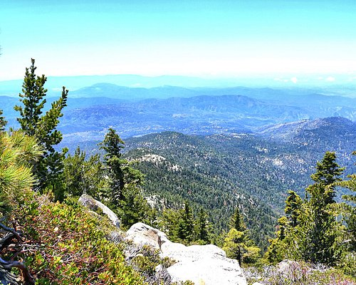
When have you had a mountain-top experience?
How did it propel you?
How does silence help you in profound moments?
How do you find living in the “normal” after a mountain-top experience?

