Slide 1
If you were announcing the wonder of
Our Triune God, what would you say?
How are you feeling as you proclaim
this wonder?
What affected you as you listened
to the scriptural words that
point to this wonder?

Slide 2
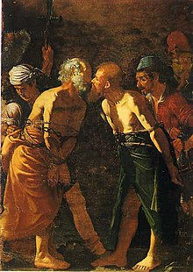
Alonzo
Pause and reflect on Paul’s words
that support the Trinitarian aspect of
the grace of our God in 3 persons.
How does the “peace” of God,
that Paul declares, wash over you?
Alonzo Rodriguez – Farewell of Sts. Peter and Paul

Slide 3
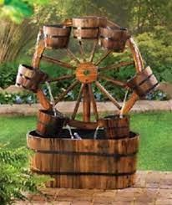
Imagine yourself as part of a water wheel. What is it like to be filled with Trinitarian love?
As you spill that watery love, what does this action mean to you? Where does the water go?
What is it like when your bucket is emptied out or as your bucket rises again to be filled with this watery love?
How would you respond as a spinning, whirling top of perfect infinite love?

