Slide 1
Paul says we are part of the “One Loaf” of Eucharist for the world. What moves or inspires you to this participation?
How does participation in the One sustain you?

Slide 2
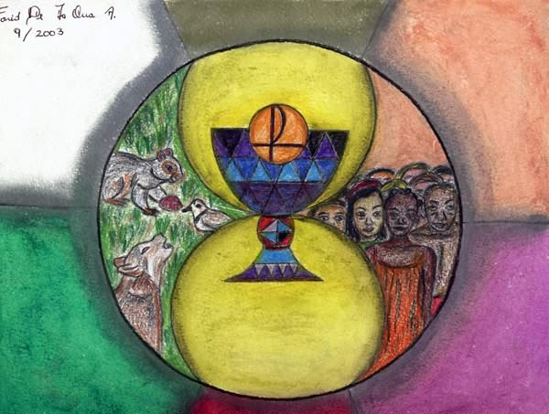
How do you relate to being a constituent part of the living Body of Christ?
How has your experience of Real Presence or Eucharist expanded or changed?
How are you offering yourself as Eucharist to the world?

Slide 3
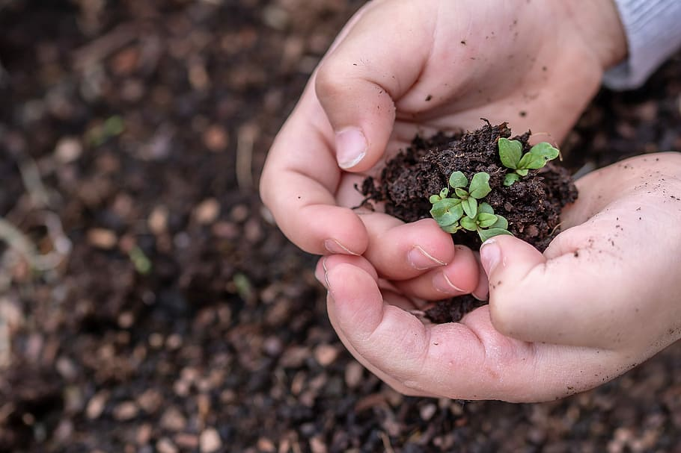
In acting justly, loving with mercy, and walking humbly, how have the seeds of faith grown for yourself and others around you?
Most of us here are “seasoned.” How do you celebrate what your hands have sown?

