Slide 1
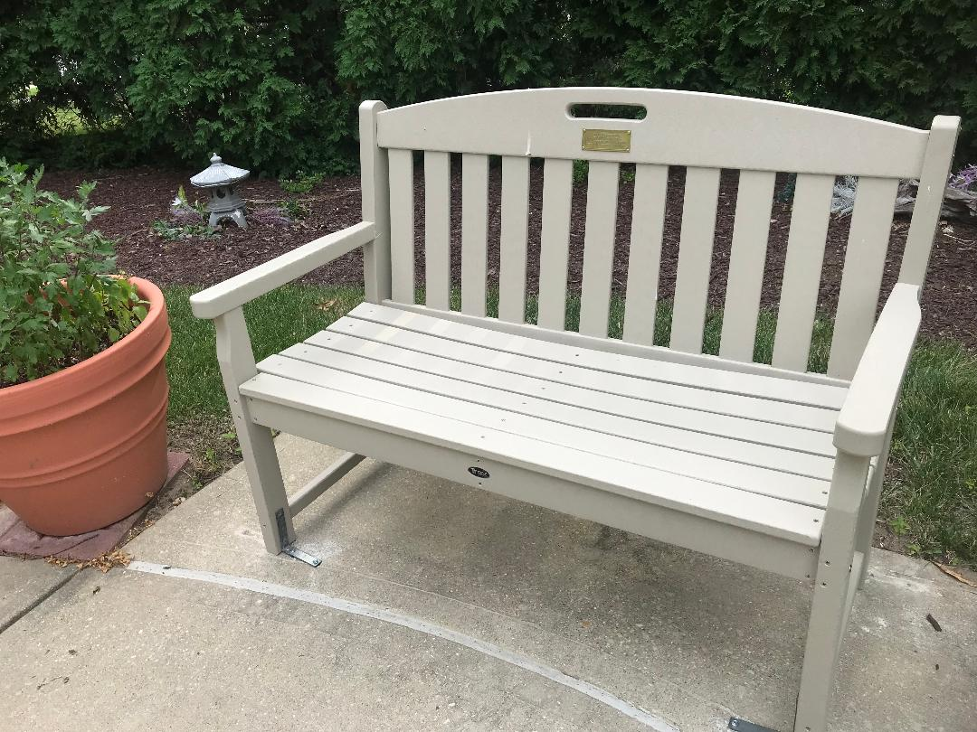

Slide 2
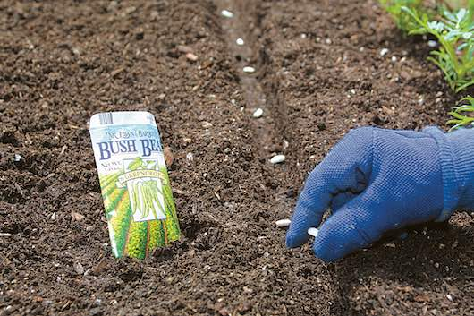
Think of a time when you hoped to be welcomed and were not. How did you react?
How have your travels in life planted seeds of the reign of God in you?
How are you planting seeds of the reign of God?

Slide 3
Whose words or presence have you been soaking up lately? How have they helped you in the “organic process of growing”?
What emotions or sensations have “struck you like lightning” in recent times, and how did your growth change?

Slide 4
How much do your choices express the view of justice that Christine sees in Jesus?
How do you stay focused on your own “watering and weeding” instead of constantly checking for progress?

