Slide 1
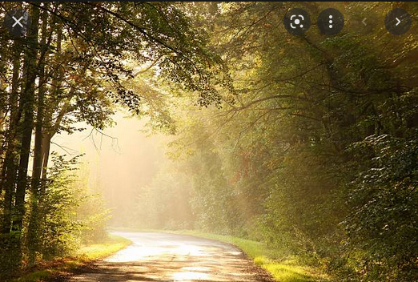
To whom am I called to be a compassionate neighbor today?
When have I experienced the generosity of a ‘stranger
on the road’…?

Slide 2
What is my usual way of shining Christ’s light on the world around me?
How do I spill light in our broken world when I am wounded and broken?

Slide 3
When have you been the one in need and what was it like to receive help?
Which of these Beatitudes for Carers feels most like you, or least like you?
Reflect on a time in your life when someone’s presence helped you to bear the unbearable.

