Slide 1
v
What does it feel like to know that Yahweh says to you,
“I knew you before I formed you?”
To whom does God command you to speak? What is it God wants you to say?

Slide 2
v
What does it mean to have “love empower us to respond beyond our feelings”?
When you feel righteous anger, how do you consider "what love embraces" and "what love resists"?

Slide 3
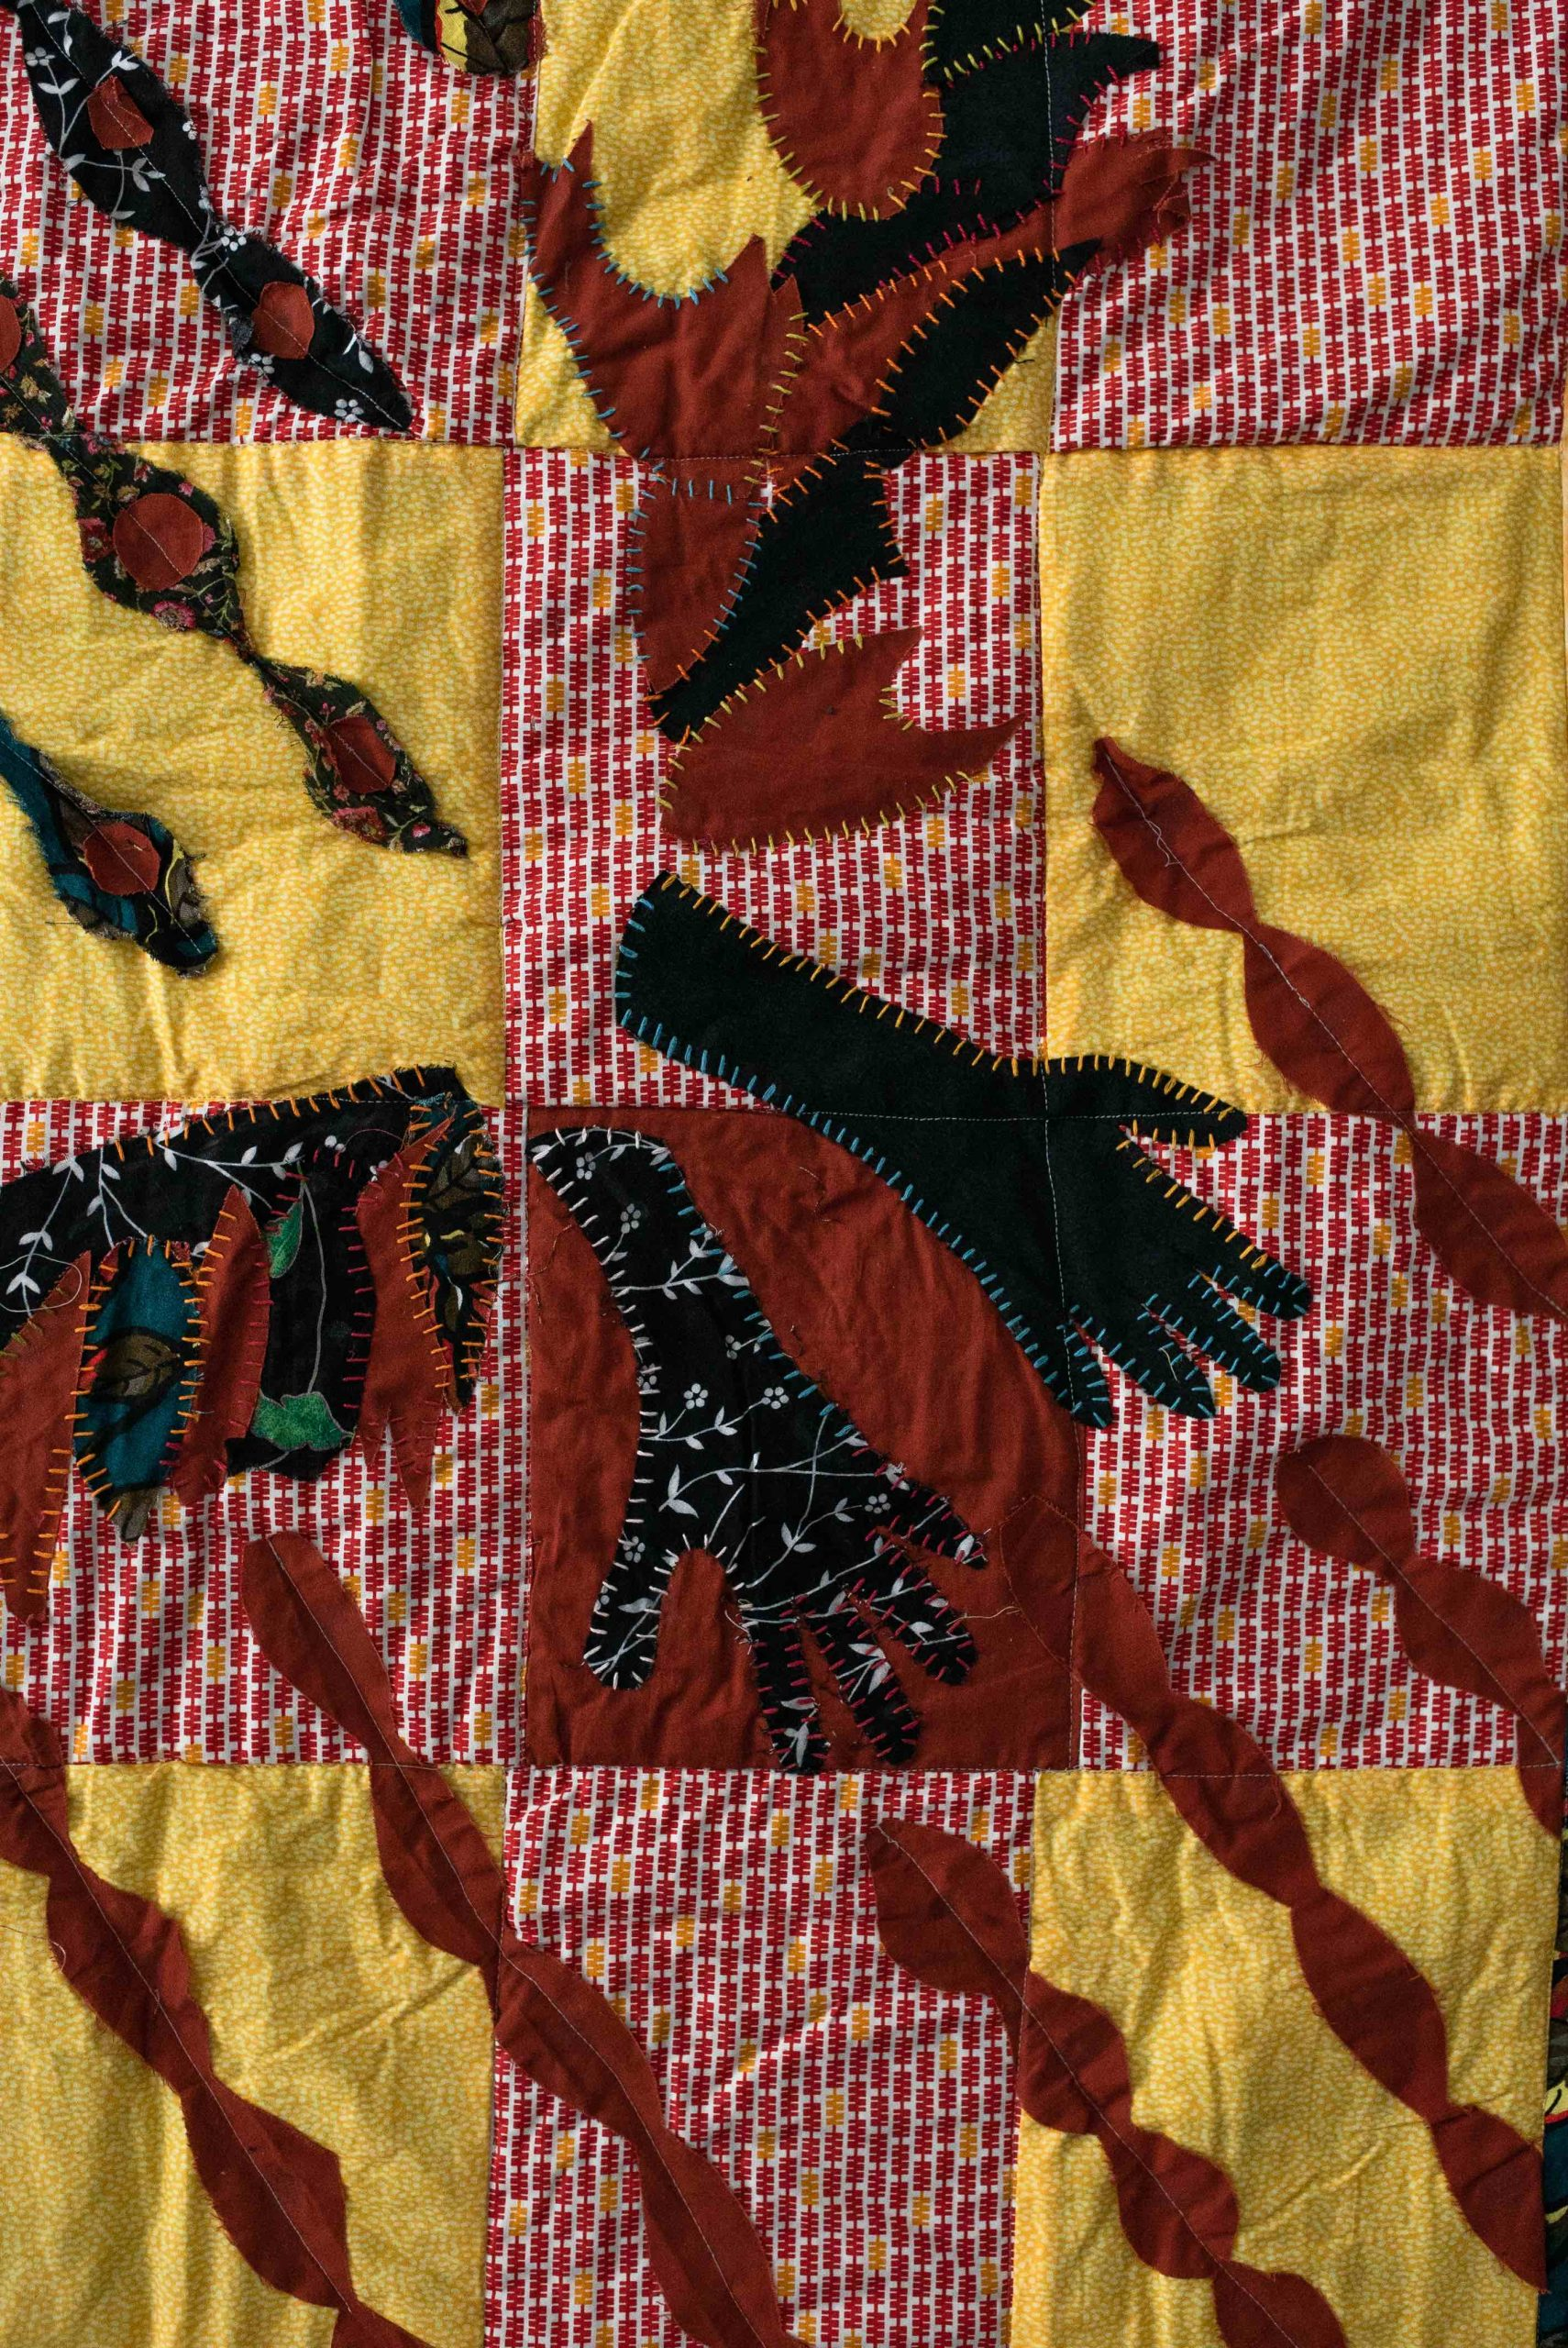
v
How are you challenged to respond when Christianity is being used to define and defend nationalism?
Whose voice are you ignoring because it makes you uncomfortable?

