Slide 1
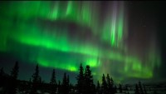
v
Imagine Isaiah saying to you: “Rise up in splendor!
Your light has come, the glory of God shines upon you.” How do you react?
Of all the things promised in this reading, what resonates with you as important today?

Slide 2
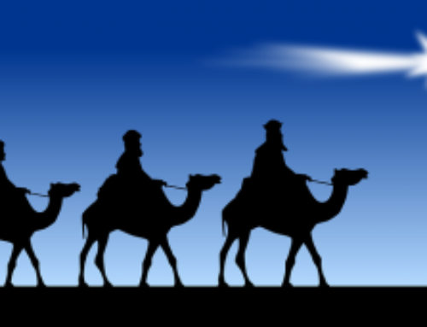
Picture yourself in the stable. When you see the babe in the manger, what stirs within you?
Staying in the stable, how do you react when you see
the “wise men” approaching
on their camels and then
offering gifts?
What gift would you want to
offer the baby? How would
you present it?

Slide 3
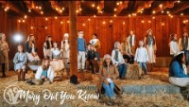
v
Ponder what Mary -- and you -- came to know about this child.

