Slide 1
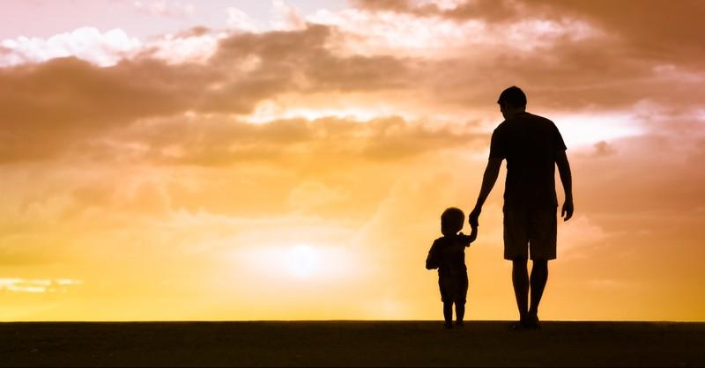
What is the particular blessing you feel today as an adopted child of God?
How do you respond to: “in the fullness of time, God sent his Son,
as a ransom under the law”?

Slide 2
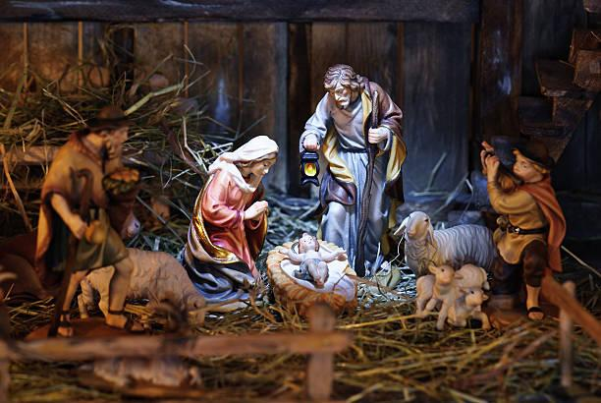
Put yourself in the stable and sense
your reaction as the shepherds say what the angels told them about this child.
What is the amazing news of this day
for you?
What might you say to Mary?

Slide 3
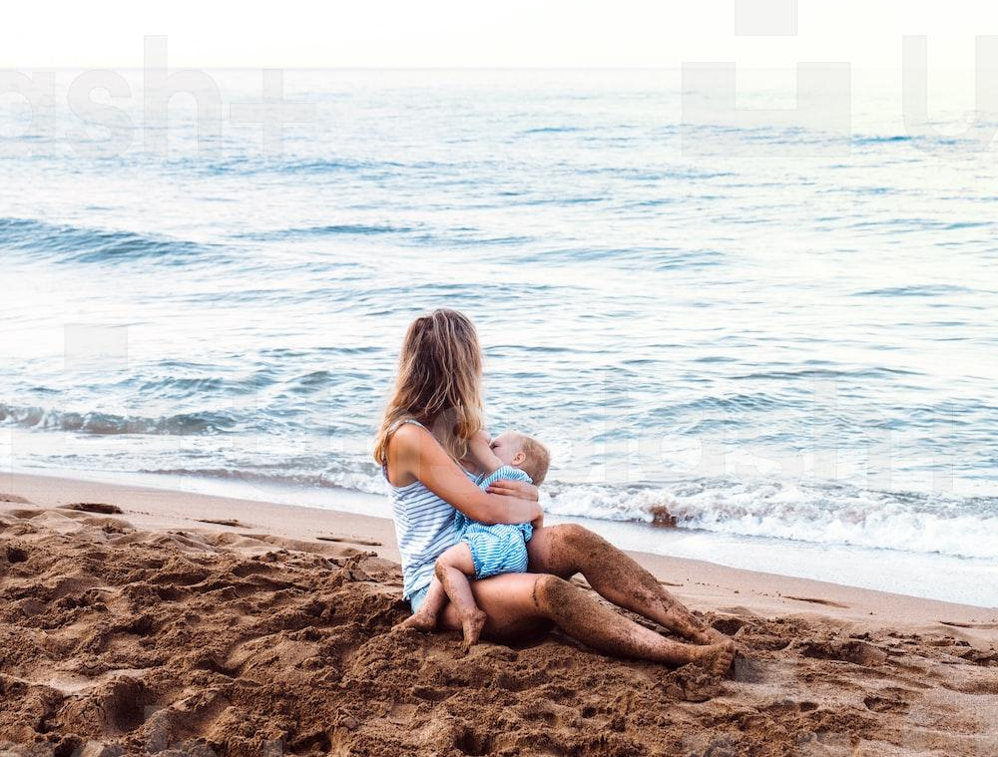
What is your feeling or response about: “blessing restores life and gives the strength”?
Respond with your feelings: “Together with a vaccine for our bodies, we need a vaccine for our hearts. That vaccine is care.”
What are you called “to find” at the beginning of this year?

Slide 4
