Slide 1
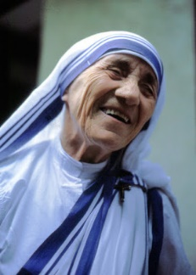
Where do you find the humble, foolish, or lowly among the faithful of today?
How have you been inspired by that encounter?
How has life invited you to embrace personal humility?

Slide 2
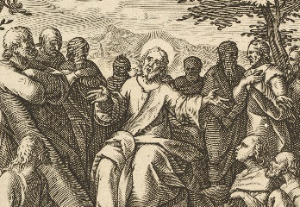
Which Beatitude has been a special blessing to you; with which do you most struggle?
What would you include in your “elevator” speech?

Slide 3
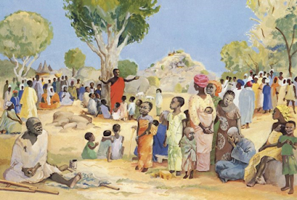
What manifestations of social transformation have given you the most joy; for what future communal transformation do you most hope?
When has it been difficult for you to set foot on the “alternative path?”

