Slide 1
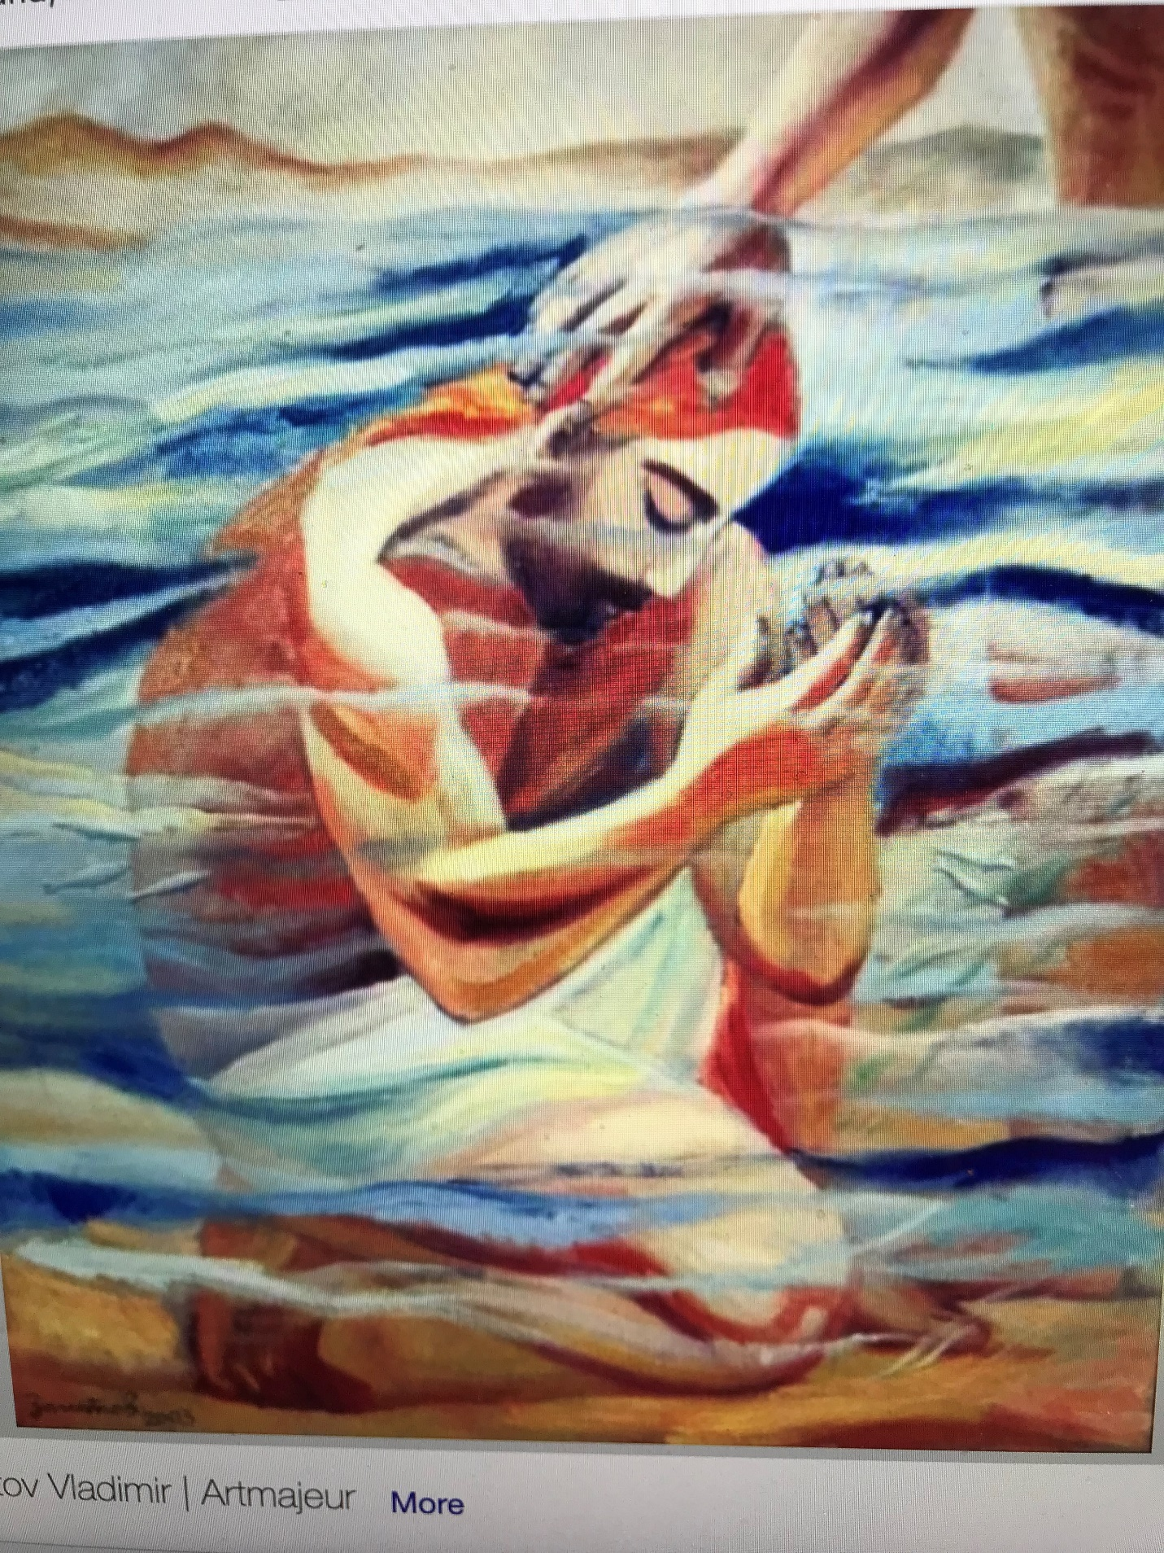
Reflect on why Jesus insisted
that John baptize him.
How has your understanding or experience of baptism evolved through the years?
Most of us here today were baptized as infants at least 50 years ago. These baptisms were typically private rituals. How would you feel about being baptized as an adult in a public place like a river, with strangers present?

Slide 2
How does this understanding of baptism affect your way of seeing others near you and in the larger world?
What does it mean for you to look at the world through the eyes of Jesus?
Recall a time when you looked at a person or situation through the eyes of Jesus and saw something unexpected.

Slide 3
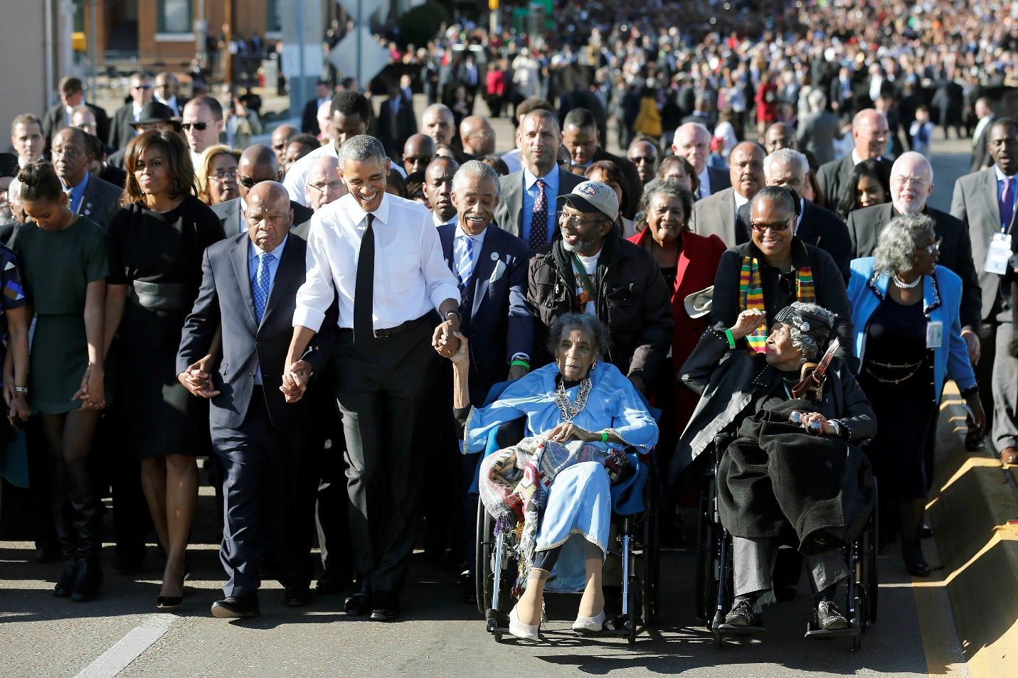
How do these readings move you into a change of heart and a way of seeing others?
In what ways are you called to stop dividing people into “good” and “bad”?
Consider a person or group that it is hard for you see as children of God. (pause) Sit with the feelings that arise in you.

