Slide 2
How do these words of Jesus
make you squirm?
What obstacle is blocking your vision?
To what new possibilities might Jesus be calling you?

Slide 3
As you bask in the unconditional love of Jesus, how are your judgmental thoughts unmasked?
What do they reveal?
What is the sugar in your life?
How can you find and remove what makes you “blind” or
allows you to see others’ faults and not your own?

Slide 4
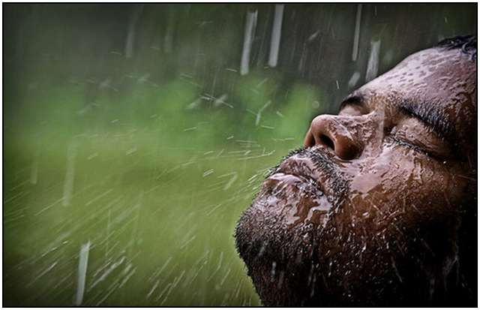
When has someone’s
honest humility awakened your honest humility?
In what ways do you participate with God’s work in your healing?

