Slide 1
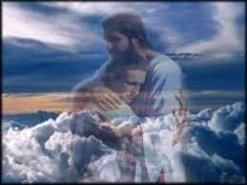

Slide 2
Just rest into a time you have felt being gathered into God's arms or being carried close to Jesus’ bosom.
How do you feel the glory of the LORD has been shown or expressed to you?
Hear and feel God speaking to YOU in Isaiah’s words: Comfort, I give comfort to you. I speak tenderly to you and proclaim that your guilt is expiated.

Slide 4
Reflect on your highway of life and see your road with whatever has happened,
e.g., hills, valleys, potholes, bridges, blockades, large or small rocks, etc.
How would you respond if in your heart you heard God say to you:
“I am sending my messenger ahead of you, who will prepare the way”?
How would God be calling you to act? How do you respond?

Slide 5
Wait on the Lord
Whose day is near.
Wait on the Lord.
Keep watch. Take heart.

