Slide 1
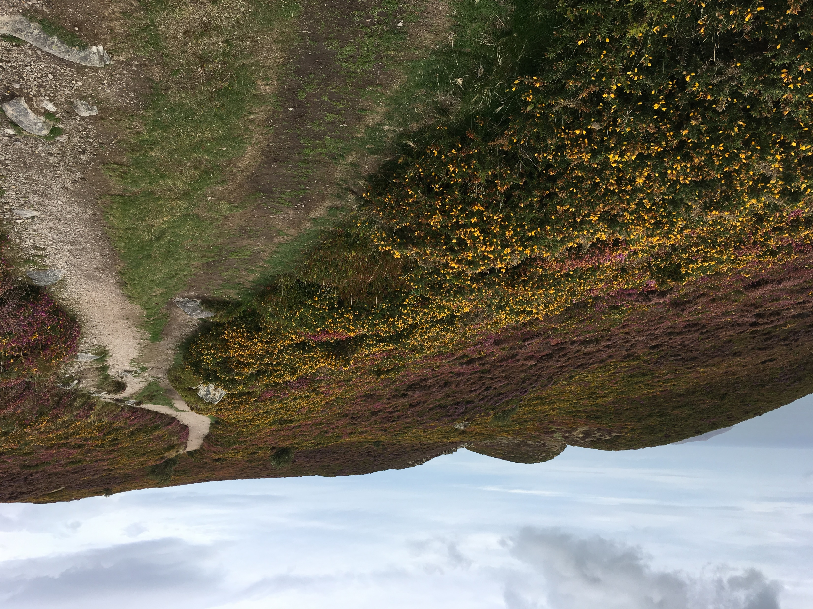

Slide 2
How are you preparing
the way of the Lord?
For yourself? For others?
How do you make your heart open to the coming of Jesus in your life right now?
Every day?

Slide 3
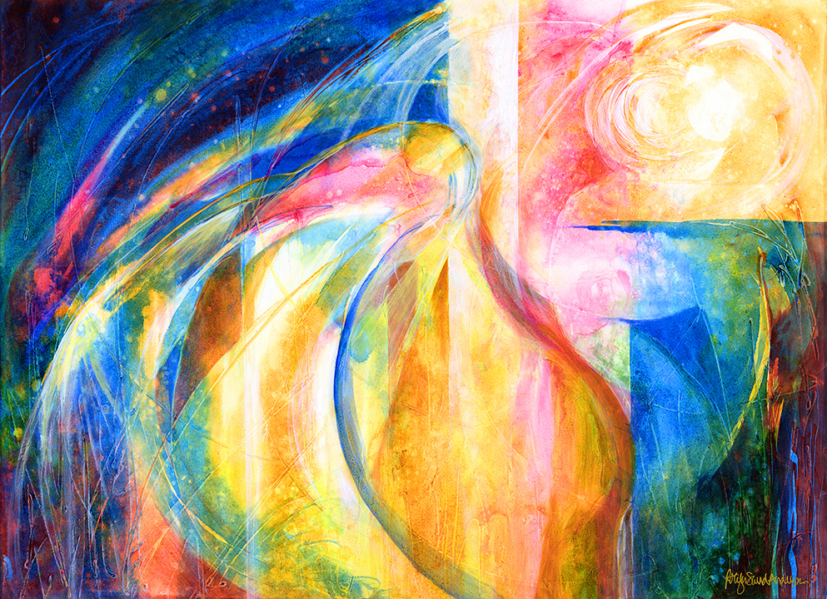

Slide 4
How do you feel the Spirit of the Lord upon you? How do you know it’s
the Spirit and not something else?
If you were to create a canticle, a hymn of praise to God, what image or phrase would be at its center this Advent?

Slide 6
What gets in your way of experiencing
that deep down quiet joyfulness?
What’s it like for you to hear your name in
“A person named _______ was sent from God”?

Slide 7
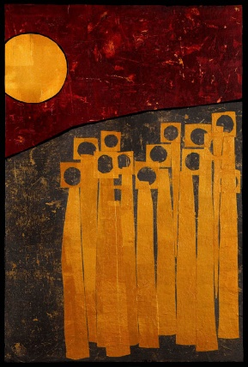
Wait on the Lord
whose day is near.
Wait on the Lord.
Keep watch. Take heart.

