Slide 1
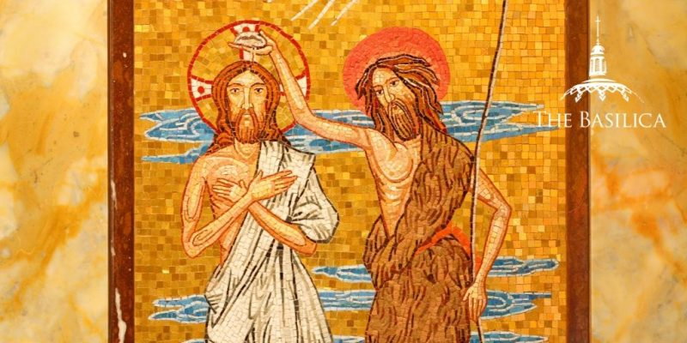
Imagine you are a disciple of John the Baptist. (pause)
Jesus speaks to you of both his and John’s works.
How are you feeling and what are you thinking?
Whether physically or in other ways, when have you gone
outside your comfort zone to take a look at someone you thought might be a prophet?

Slide 2
Reflect on what it is like
that your heart is
the sacred crib from which Emmanuel will emerge.
What is your Advent waiting prayer?

Slide 3
Think of someone in your life
who exemplifies
prophetic patience.
How have they lived that
in their community?
When you have been in
a situation where "patience
is no longer reasonable,"
what have you done?
Where are you called to be patient but not to settle?

