Slide 1
Corpus Christi

Slide 2
THEY'LL KNOW WE ARE CHRISTIANS
(8-bar introduction)
We are one in the Spirit,
We are one in the Lord,
We are one in the Spirit
We are one in the Lord,
And we pray that all unity
may one day be restored:
And they'll know we are Christians by our love, by our love,
Yes, they'll know we are Christians by our love.
We will walk with each other,
We will walk hand in hand,
We will walk with each other,
We will walk hand in hand,
And together we'll spread the news
that God is in our land:
And they'll know we are Christians by our love, by our love,
Yes, they'll know we are Christians by our love.

Slide 3
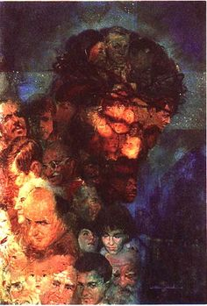

Slide 4
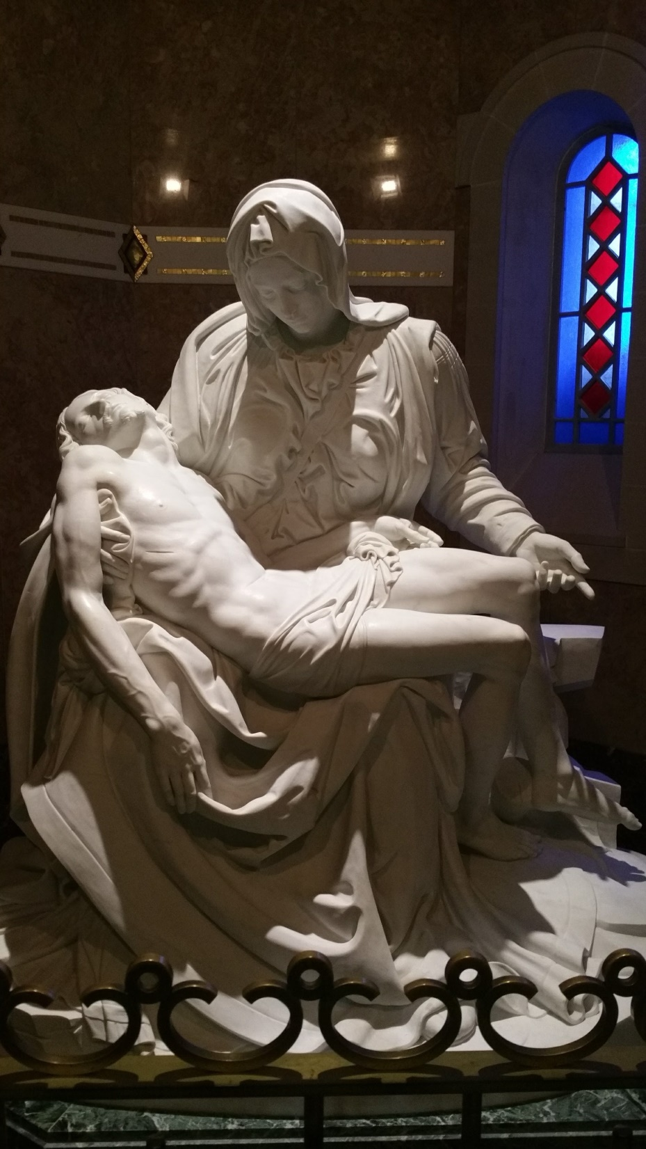

Slide 6
City of God
by
Dan Schutte
Awake from your slumber! Arise from your sleep!
A new day is dawning for all those who weep.
The people in darkness have seen a great light.
The Lord of our longing has conquered the night.
Let us build the city of God.
May our tears be turned into dancing!
For the Lord, our light and our love,
Has turned the night into day!
We are sons of the morning, we are daughters of day!
The One who has loved us has brightened our way.
The Lord of all kindness has called us to be
A light for all people to set their hearts free. (Chorus)
God is light, in God there is no darkness!
Let us walk in God’s light, God’s children, one and all.
O comfort my people; make gentle your words.
Proclaim to my city the day of her birth! (Chorus)

