Slide 2
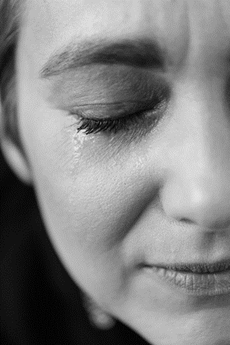
What word or phrase in the Gospel
stayed with you?
What boundaries do you maintain to excuse your not responding to people in need?
Jesus needed a persistent stranger to
call him beyond his bias. To whom should you be listening to challenge the limits
of your compassion?

Slide 3
How was it for you when you advocated for someone despite criticism?
What can you do to widen acceptance of all people within the Church?
Whose burdens feel outside the borders of your solidarity?

Slide 4
What word or phrase in the reading stayed with you?
What longing have you been holding back, not asking for in prayer? Try it out now, as a prayer….

