Slide 1
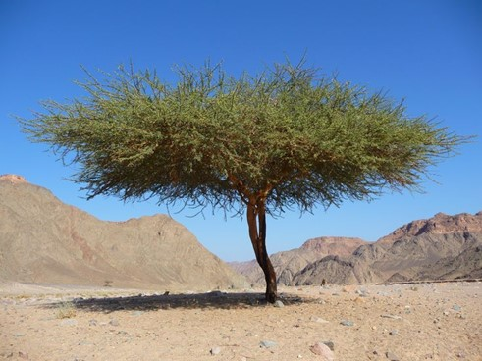
Elijah sat down by
a broom tree that shaded him
from the desert sun.
What protects you
from the trials in your life?
What is the bread of life that
sustains you at your
most desperate moments?
When have you been touched by an angel who recognized your needs? How did that feel?

Slide 2
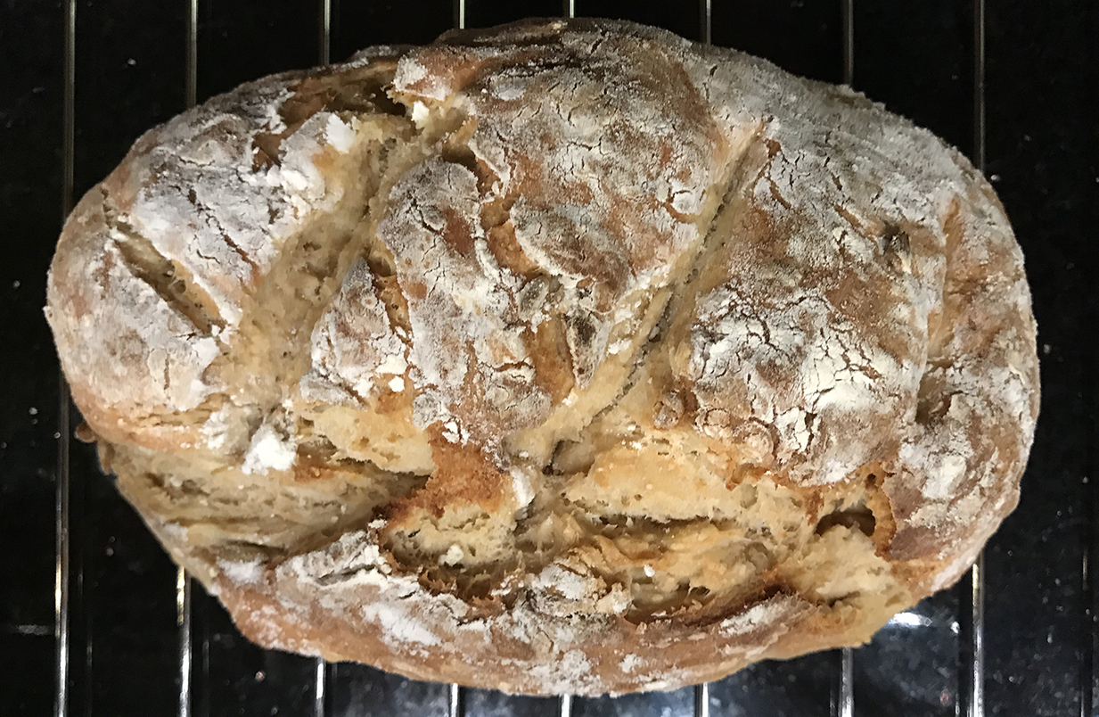
Whose holiness have you
overlooked because
they were familiar?
Reflect on Jesus saying: “I am the bread of life.”
What image or feeling comes into your heart?
How have you experienced Jesus as the bread of life?

