Slide 1
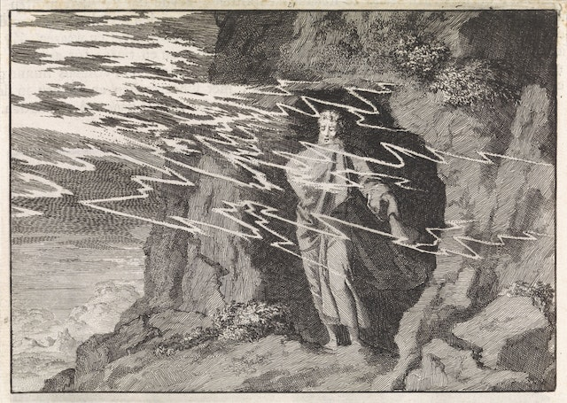
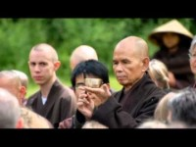
What helps you hear the still, small voice amid the noise?
What is your cave of refuge?
What comes to you when
you are there?
What words or images
from this reading speak
to you right now?

Slide 2
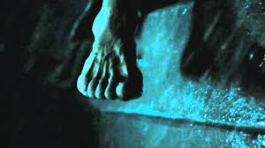
Who or what has called you to step with confidence out of your boat?
When have you called,
“Jesus, save me!”
expecting his hand,
and received
something else?

Slide 3
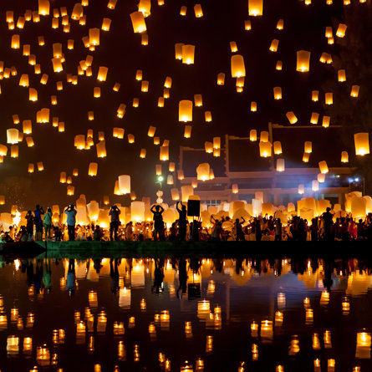
What in your life has prepared you so that you are made for this time?
When have you admired
an act of audacious faith? How might that influence your own next actions?

