Slide 1
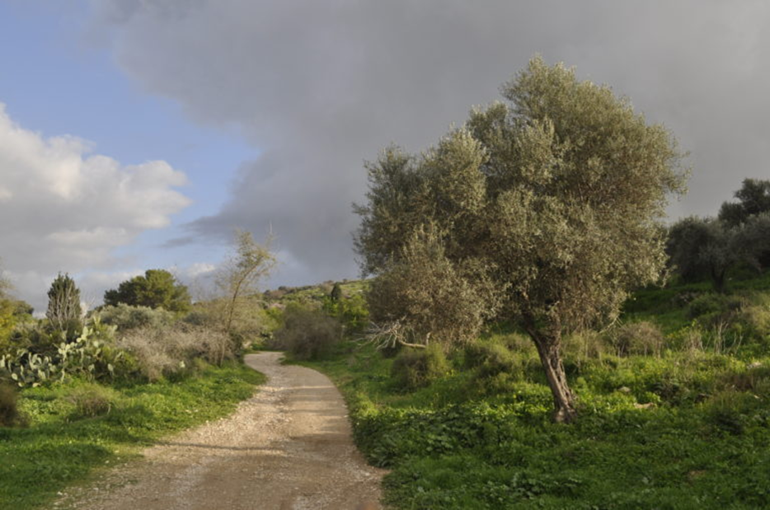

Slide 2
Consider a time when you felt consumed by grace,
or full of God’s light.
When you were in your late teens (like Catherine in this reading), what groups did you choose to join?
How have those groups influenced you,
or you influenced them?
What or whom are you carrying on your shoulders?
At what risk?

Slide 3
Recall your feelings from a time when you stubbornly
spoke up for what’s right, with love –
or when you did not do this.
Catherine’s clarity came from her joyous unity with God.
When have you felt your speech or action
was united with God?

Slide 4
Who or what helped you to recognize your gifts?
Whom have you helped to know their gifts?
In which of your gifts are you most confident?
How would it be for you to live like the early Christians, in prayerful communal life?

