Slide 1
When has your faith given you
the confidence you needed to take a step in the dark?
How have you shared your faith to
bolster the flagging spirits of someone who was
bowed down by a burden?
What do you imagine will be most pleasing to Christ when you appear before Him?

Slide 2
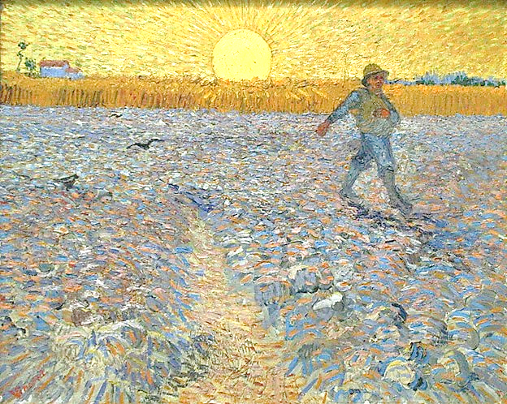
When have you scattered a seed and witnessed exponential growth as if the seed had a life of its own?
When have you been surprised by goodness springing forth unexpectedly from an unlikely source?

Slide 3
When have you encountered the Spirit in a way that you never imagined?
Can you recall an instance when
you turned over the steering to God; how did that feel?

