Slide 1
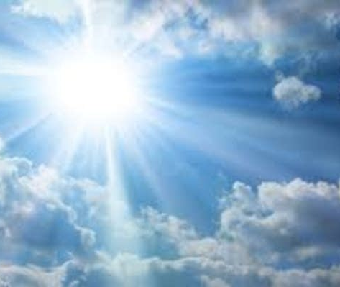
Imagine that you are standing in the crowd as sacrificial blood is gathered and all the teachings and requirements of the covenant are being proclaimed. How do you react?
The church today uses rituals to emphasize the presence of Christ among us. Do any of these rituals draw you into worship? What happens within you?

Slide 2
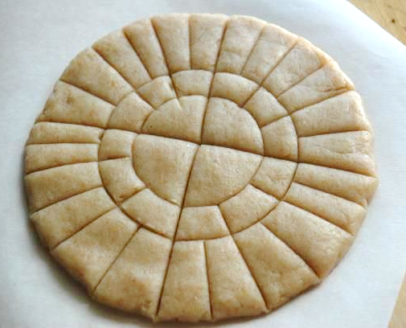
Imagine that you are at the table when Jesus tells his followers to take the unleavened bread and says, “Take it; this is my body.”
How are you affected by his saying, “I shall not drink again the fruit of the vine until the day when I drink it new in the kingdom of God.” As you hear his words, how do you respond inwardly regarding God’s kingdom being already here and still not yet complete?

Slide 3
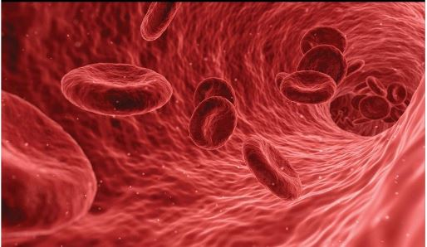
How does Jesus’ gift of his body heal you?
How does your physical body help you – or hold you back – in being fully part of the body of Christ?

