Slide 1
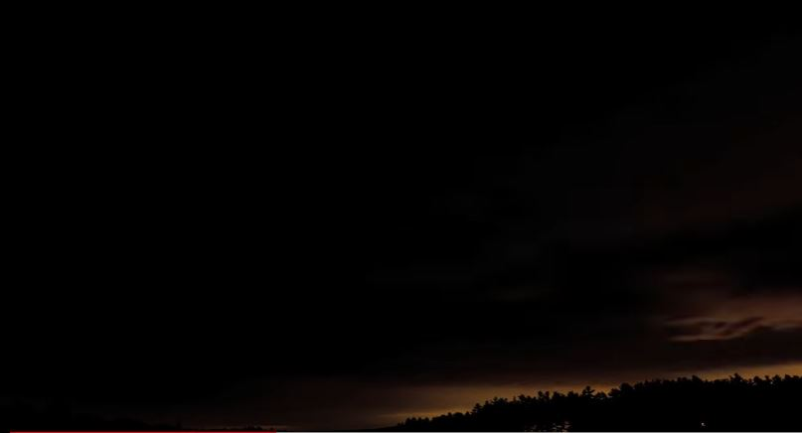
Within yourself, what opens you to the light of God?
What darkness hinders that light in you?

