Slide 1
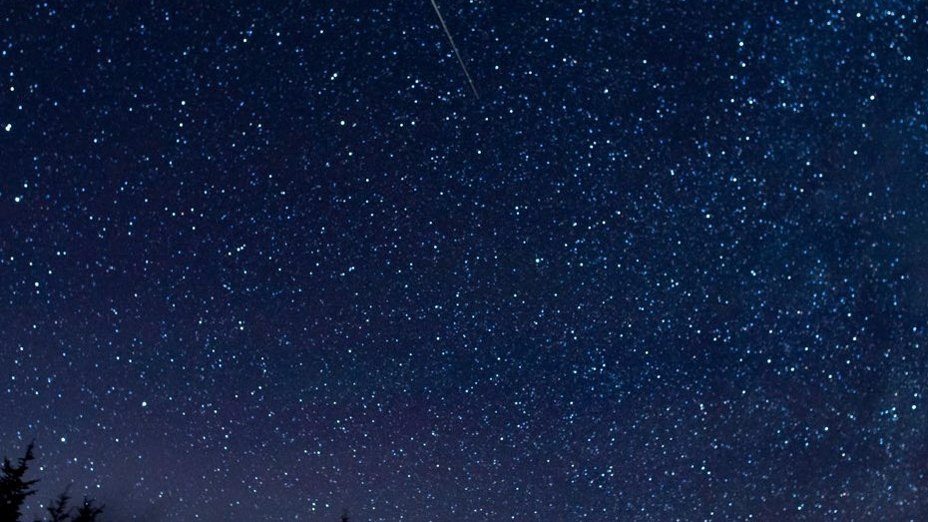
Enter the silence
as one of the characters or images.
What is the story now like for you?

Slide 2
How are you the glory that is from God,
full of grace and truth?
How do you hold God’s light that
cannot be overpowered by darkness?

Slide 3
It’s in every one of us
to be wise.
Find your heart,
open up both your eyes!
We can all know everything
without ever knowing why.
It’s in every one of us by and by.
(by John Denver)

Slide 4
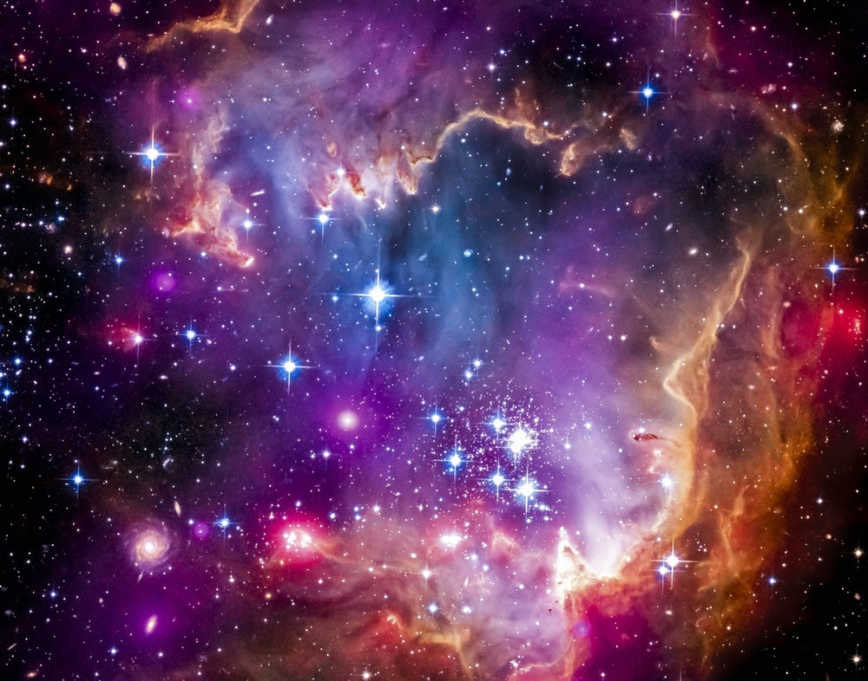
How do you
give birth to God?
How do you experience incarnation?
What simple acts
incarnate Christ for you?

Slide 5
