Slide 1
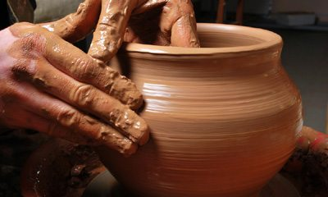

Slide 2
How has God been shaping and smoothing you through the events of recent months or years? How have you been pliable and how have you resisted God’s shaping?
We’ve just heard that eye has not seen and ear has not heard
what God is preparing for us. How do you feel about that uncertainty?

Slide 4
When you watch for God’s action, what are you looking for?
How do you wait when God seems out of sight?

Slide 6
What new life are you expecting to grow in you during this Advent?
How will you create a space where you still yourself and listen during this Advent?

Slide 7
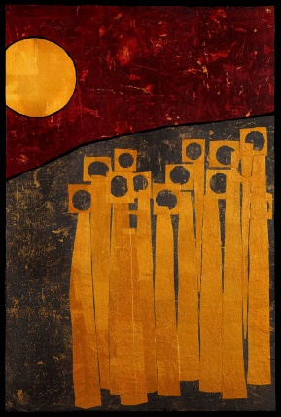
Wait on the Lord
Whose day is near.
Wait on the Lord.
Keep watch. Take heart.

